Slide 1


Imagine If… Assets for Success Productivity Programme
Louise Cole and Kevin Feaviour
“Full STEAMM Ahead”
Exeter and Heart of Devon Employment and Skills Board
25th November 2016

Slide 2

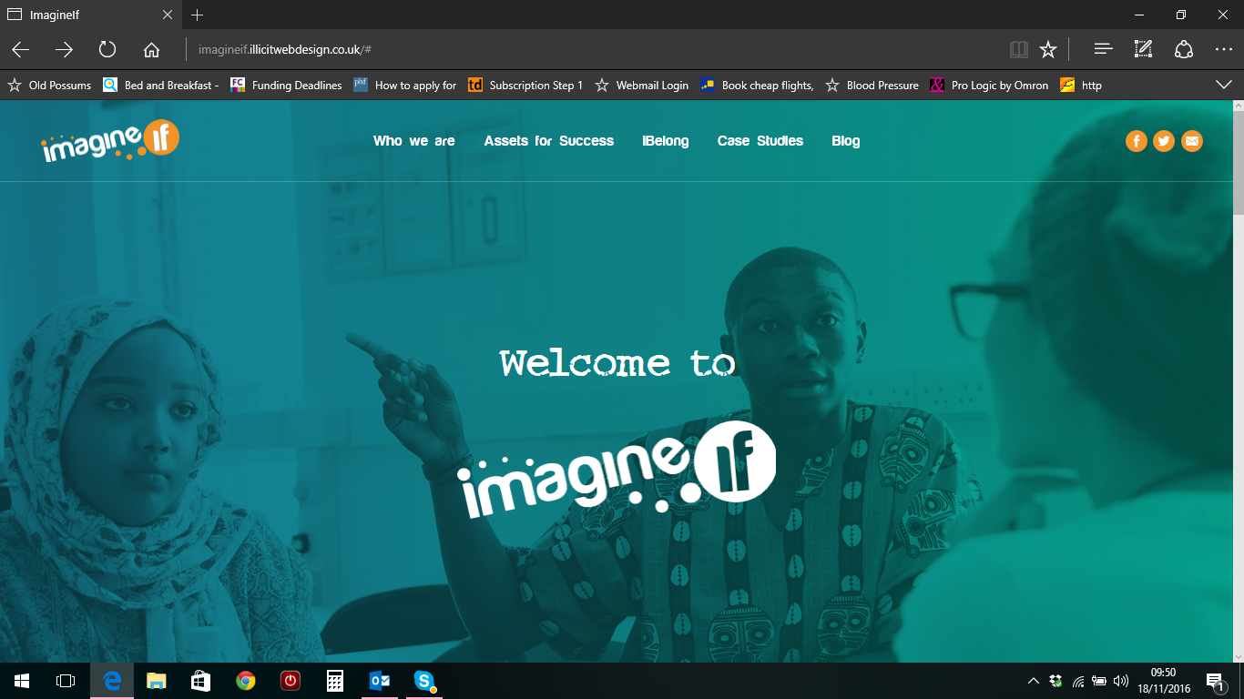


Slide 3
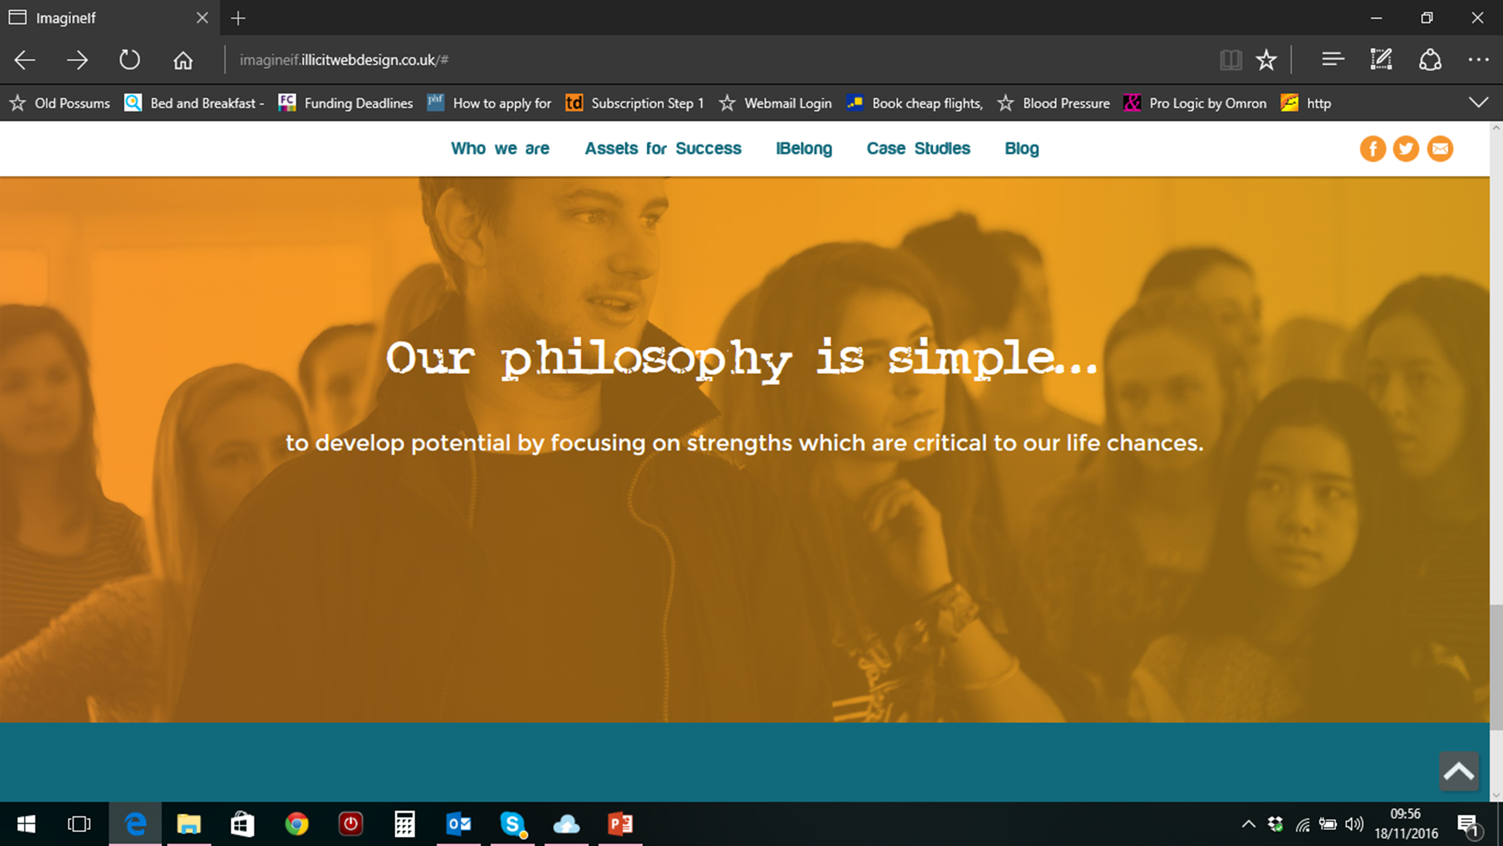

Slide 4
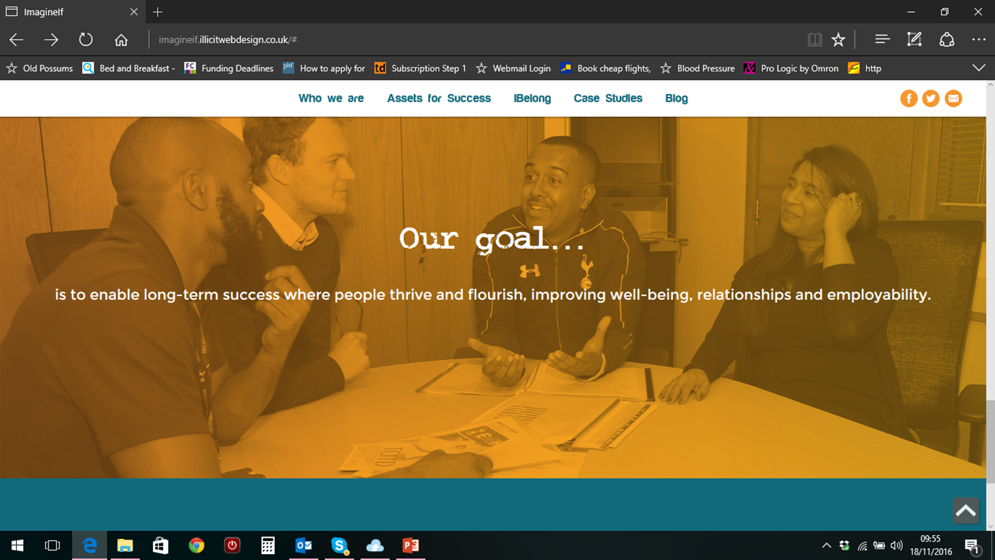

Slide 5
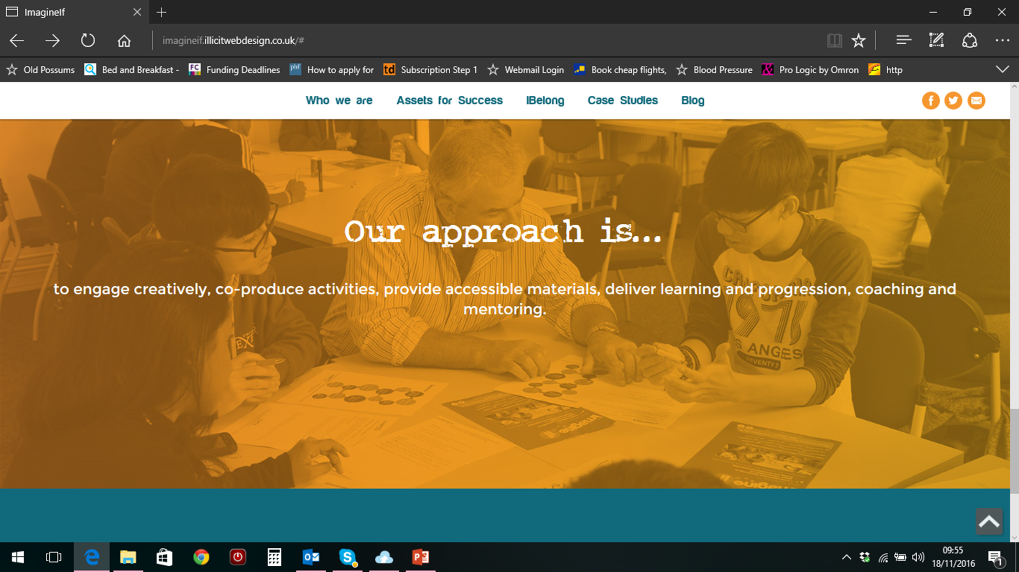

Slide 6
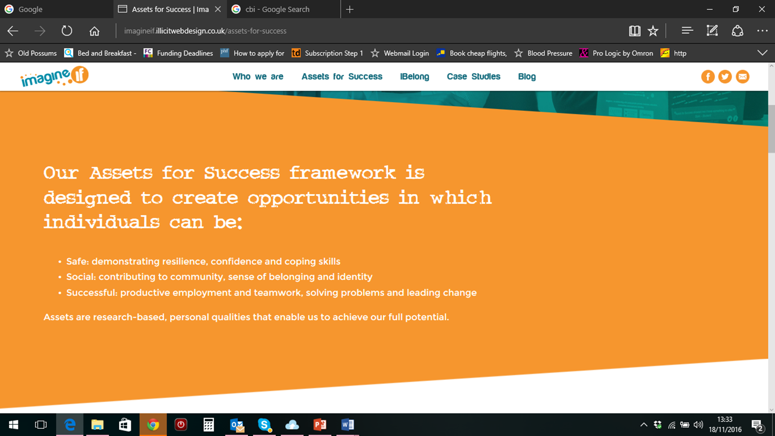

Slide 7

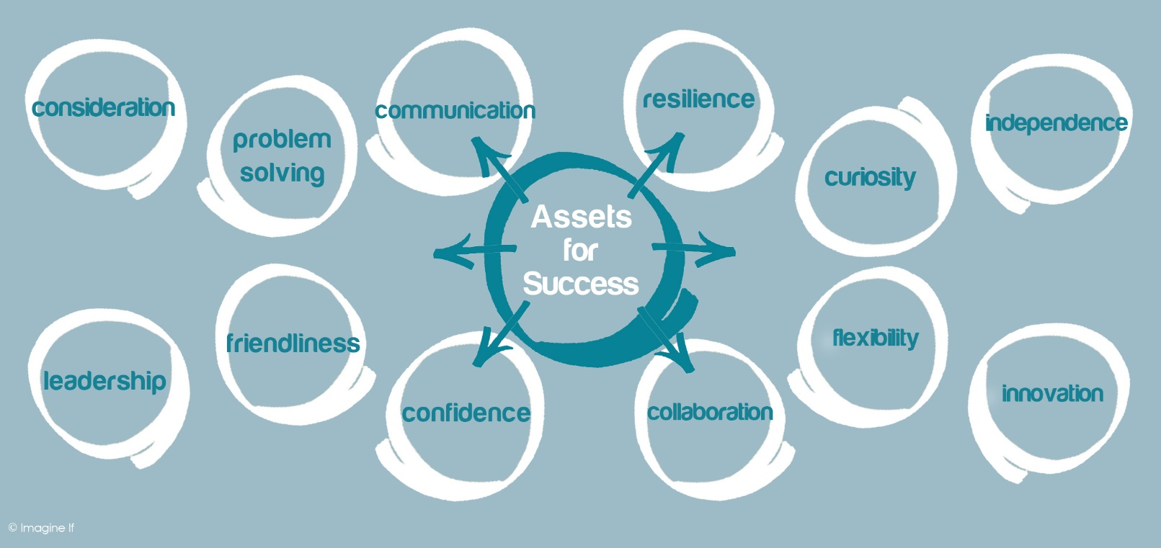
Assets for Success
Notes:
The 12 Assets - based on research about what people need for learning & work, relationships and wellbeing.

Slide 8

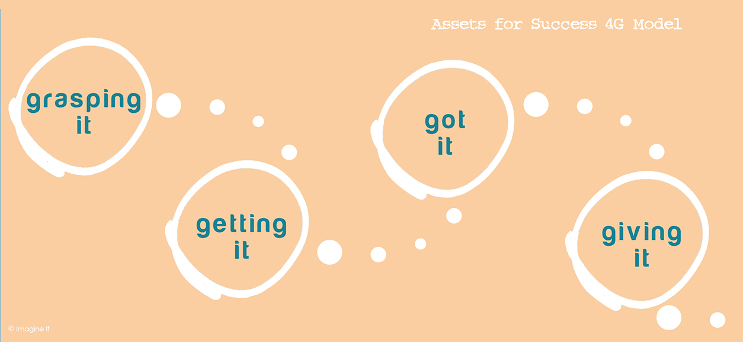
Assessing your Assets 4G Model
Identify: know your strengths
Assets for Success Personal Rating Profile: Individual Benchmarking

Slide 9



Emotional wellbeing is fundamental to our lives and being Safe, Social and Successful. Imagine If… offers the opportunity to create and develop the conditions to help people to thrive.
iBelong is just that - helping people to belong rather than left out and alone; to have access to those they can trust; supporting them to develop their coping strategies. iBelong involves building their support network to have the confidence, qualities and techniques to best respond.

Slide 10

Why these assets
Employment and productivity
  OECD, CBI, National Association of Colleges and Employers (NACE) US Talent Shortage Survey, Work Foundation, Association of Graduate Recruiters, Development Economics Research group (£88bn), UKCES, NSS
Health and Well being
  Young Minds, Youth Access, IRC, TSA, DOH

Slide 11
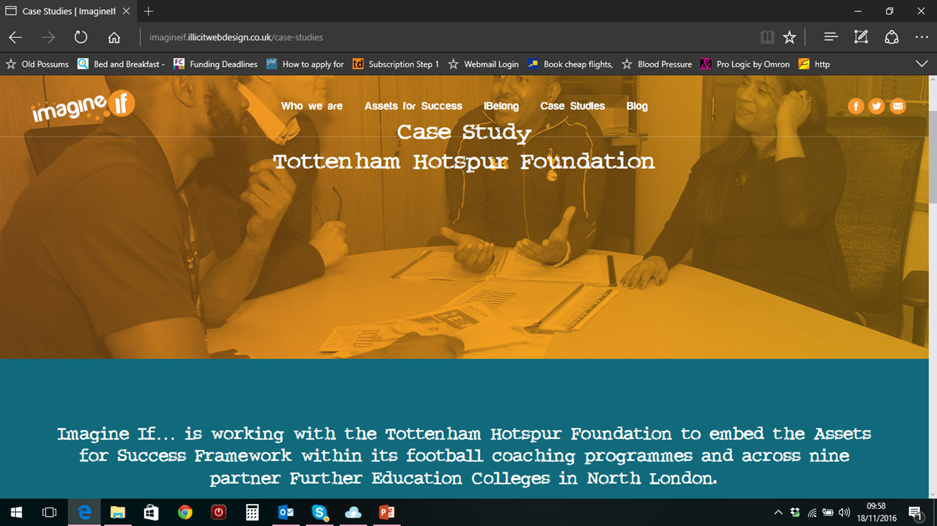

Slide 12

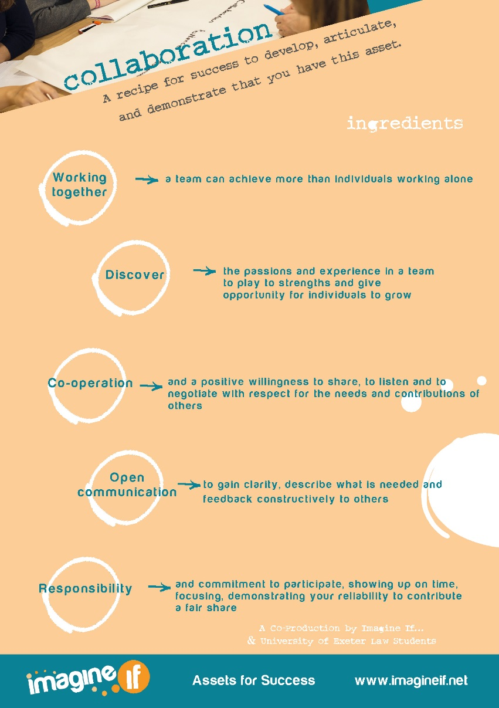
Recipe for Success

Slide 13
How do we work work?
Contextualised learning and productivity programmes.
Creative collaborations that nurture a culture of learning and development that will result in lasting change within a framework that evidences improving prospects and productivity outcomes.
Skills development
Assets for Success/ibelong
- training, mentoring, coaching,
storyboarding, resource creation
cards and video, on-line coaching
and training, participatory
facilitation.
Service development and
- strategic change management,
skills audits, team challenges and
experiential days.

Slide 14










Partners

Slide 15

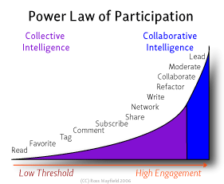
Collaboration & Participation
Ross Mayfield is an internet entrepreneur and VP of Business Development at SlideShare, the world's largest professional sharing community.
Notes:
This model relates to how people collaborate and participate through social media but it is a useful parallel to working collaboratively in a team setting – so within your syndicates this may translate to how you are working – which groups are using Quip for example – which allows you to collaborate on line and share editing and contribution to a work task. Refactoring is a controlled technique for improving the design of an existing code base. Its essence is applying a series of small behavior-preserving transformations, each of which "too small to be worth doing". However the cumulative effect of each of these transformations is quite significant. By doing them in small steps you reduce the risk of introducing errors. You also avoid having the system broken while you are carrying out the restructuring - which allows you to gradually refactor a system over an extended period of time.

Slide 16
Social and Cognitive Factors Driving Teamwork in Collaborative Learning Environments
Team Learning Beliefs and Behaviors
“Groups of people are increasingly acknowledged as the source of knowledge construction. It is expected that teams, bringing together people with different experiences, values, and knowledge, will be more effective in adequately solving the problems than are individuals…Research has revealed cases in which large variation in group work interaction and performance is encountered between teams that seem not to differ in composition and assigned task (Barron, 2000). This research indicates that fruitful collaboration is not merely a case of putting people with relevant knowledge together. Understanding is required in the factors that make up successful collaboration.”
Piet Van den Bossche, Wim H. Gijselaers, Maastricht University
Small Group Research, Volume 37 Number 5, October 2006 490-521, © 2006 Sage Publications
10.1177/1046496406292938, http://sgr.sagepub.com, hosted at http://online.sagepub.com

Slide 17
Interdisciplinary STEAMM Teams
A coordinated group of experts from several different fields who work together toward a common business goal. A business might use an interdisciplinary team of professionals to work on a complex project that requires multiple skills sets or areas of expertise in order to succeed.
What is interdisciplinary team? definition and meaning ...
www.businessdictionary.com/definition/interdisciplinary-team.html
Mission
Time
Structure
Compassionate Collaboration

Slide 18
Using the Assets for Success Framework
Interdisciplinary teams with strong collaborative abilities are the way ahead.
Discuss
How can we make it happen?
Using your Imagine If… postcards please share your thoughts about what you require within each Asset of your teams/workforce to develop the skills that will deliver effective collaboration within and across boundaries.

Slide 19
Contacts
Louise Cole
Email: louise.cole@imagineif.net
Mobile: 07881 585395
Kevin Feaviour
Email: kevin.feaviour@imagineif.net
Mobile: 07791 830861
www.imagineif.net

