Slide 1





Anka Djordjevic, Full STEAMM Ahead, The Met Office, 25th November 2016
www.facebook.com/grandchallenges
@uofe_challenges
www.exeter.ac.uk/grandchallenges

Slide 2
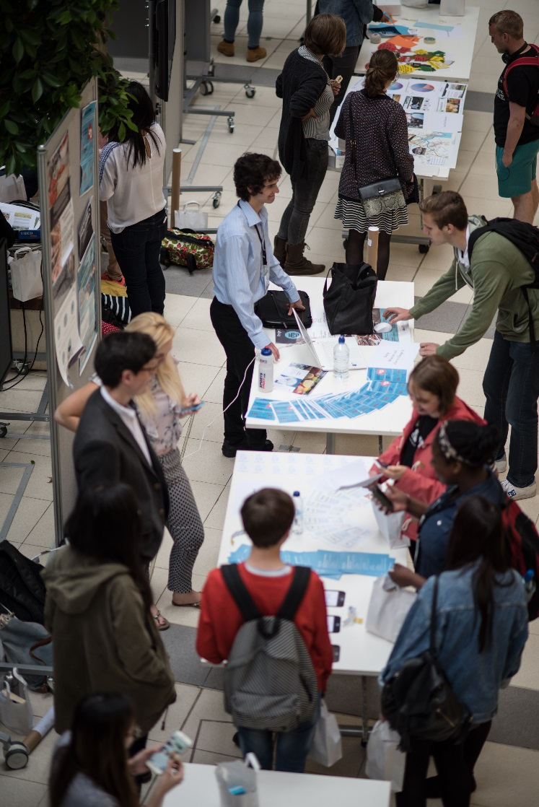
Overview
Grand Challenges explained
What students do and what they get out of it
Who we work with
Participants’ reflections
Video

Slide 3
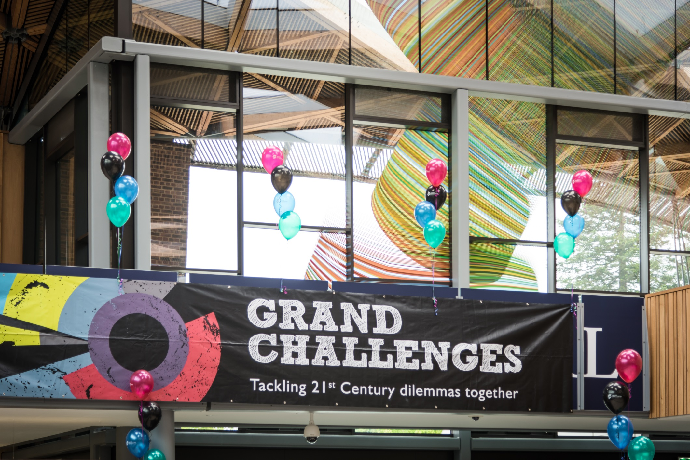
Grand Challenges is an interdisciplinary, enquiry led learning experience which improves students’ employability.

Slide 4
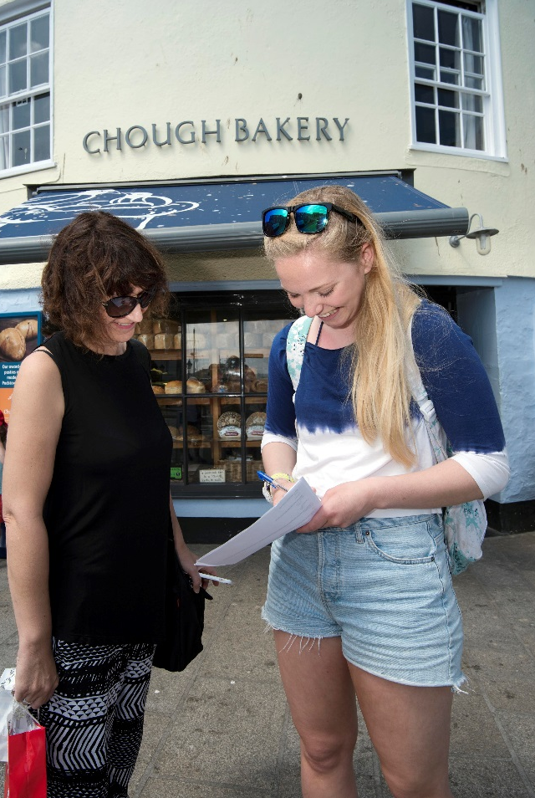
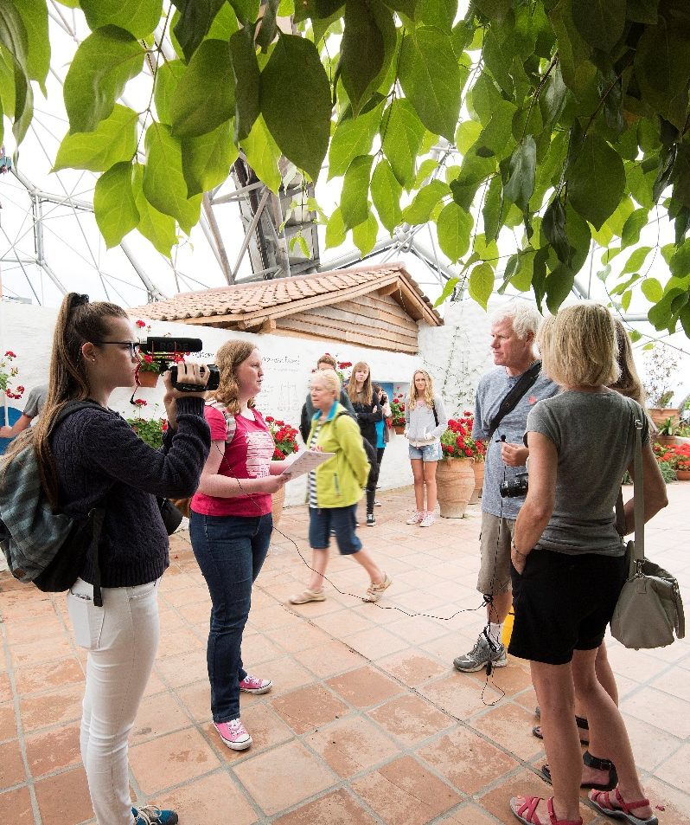
During Grand Challenges Week students choose from a range of global issues and, supported by leading academics and external specialists, carry out group research in order to create a solution.

Slide 5
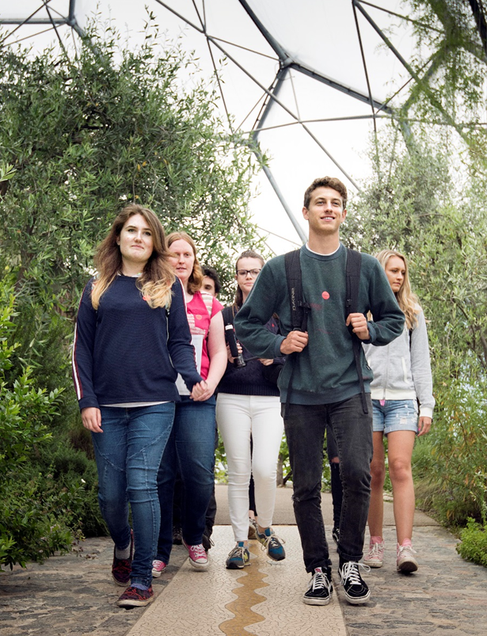
Students choose from a range of global themes and sign up to a sub-group to tackle a particular aspect of the Challenge.
Synthetic Life
Child Health
Population Pressures
Banking
Global Security
Digital Futures
Obesity Crisis
Growing Old: Burden or Blessing?
Fashion Ethics
Water Security
Food for Thought
Gender Equality
Solving the Climate Change Problem
No Health Without Mental Health?

Slide 6
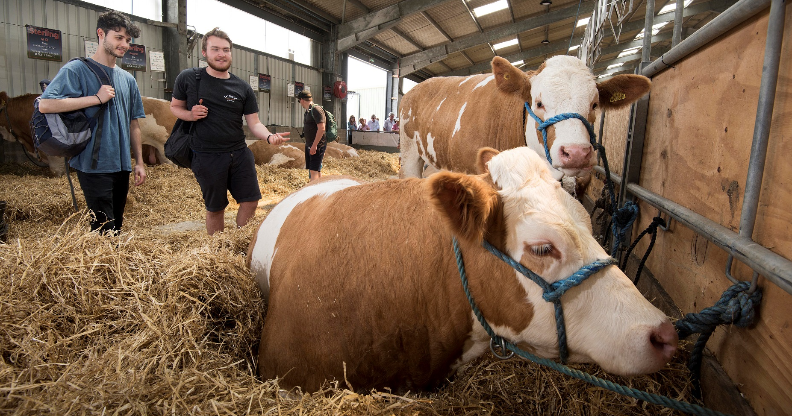
During the GC week students have scheduled sessions, field trips and other activities where they engage with top academics and external specialists, artists, community groups and invited speakers and explore the issue from different perspectives and experiences.

Slide 7
Grand Challenges explained
GS supports the University’s Education Strategy, while the themes link to Research and Impact Strategy.
GC aims to encourage research-inspired, innovative, multi-disciplinary, inquiry-led learning and improve the employability attributes of our graduates.
As part of preparation for the week, students complete a skills development programme. At the end of the week they are asked to write a reflective piece in which they look at skills they used and developed throughout the experience.
On the final day students present their work to judges in the morning and take part in an open showcase and celebration in the afternoon.
By producing their real-world solution, students feel like they’ve made a real difference. This is exciting and fun! Even if their solution folds or proves to be unrealistic.

Slide 8
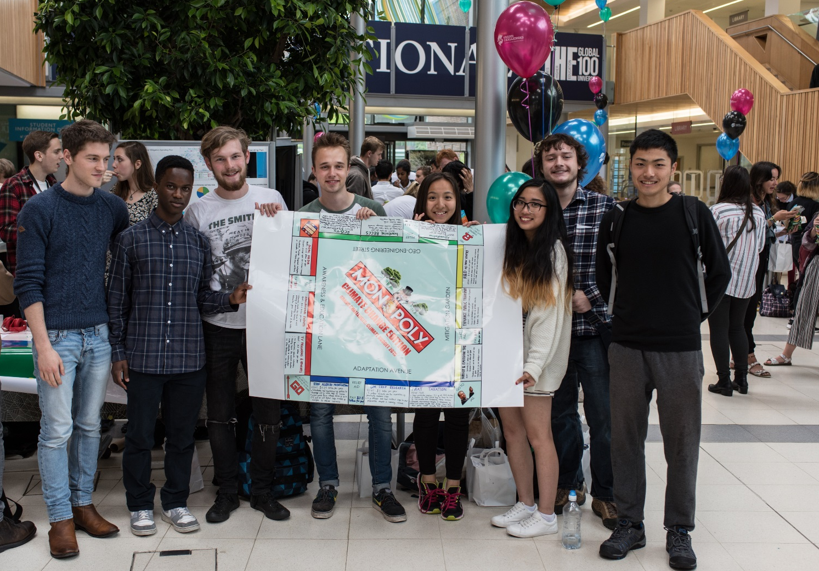
Students work in small groups during the week.
A typical group would have around ten students from different areas and levels of study.

Slide 9
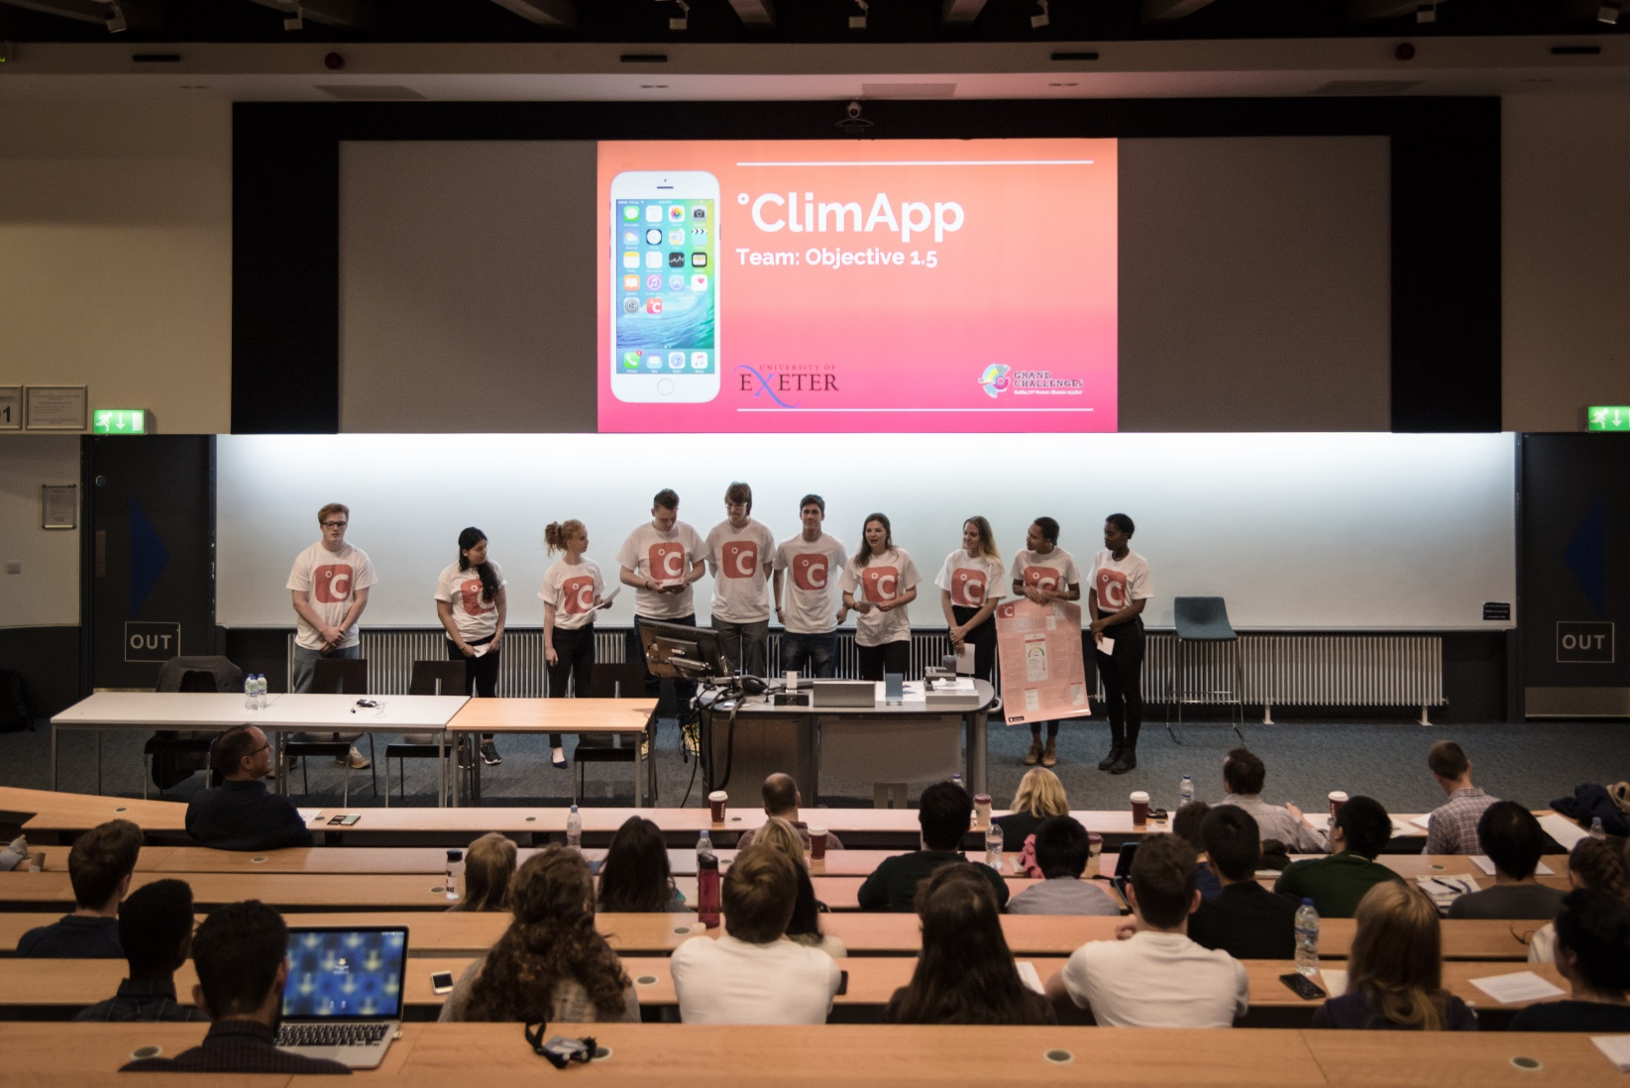
Students’ outputs include videos, social media campaigns, ministerial mini-submissions, apps, posters, games, business plans and other.

Slide 10
Non-academic collaborators
  NHS commissioners
  Rob Wainwright (Director of Europol)
  Jonathan Marcus (BBC Diplomatic Correspondent)
  Waitrose
  Samaritans
  Local businesses
  Mental Health Lived Experience Group
  Public Health
  Sir Jon Day (Former Chief of the Joint Intelligence Committee)

Slide 11
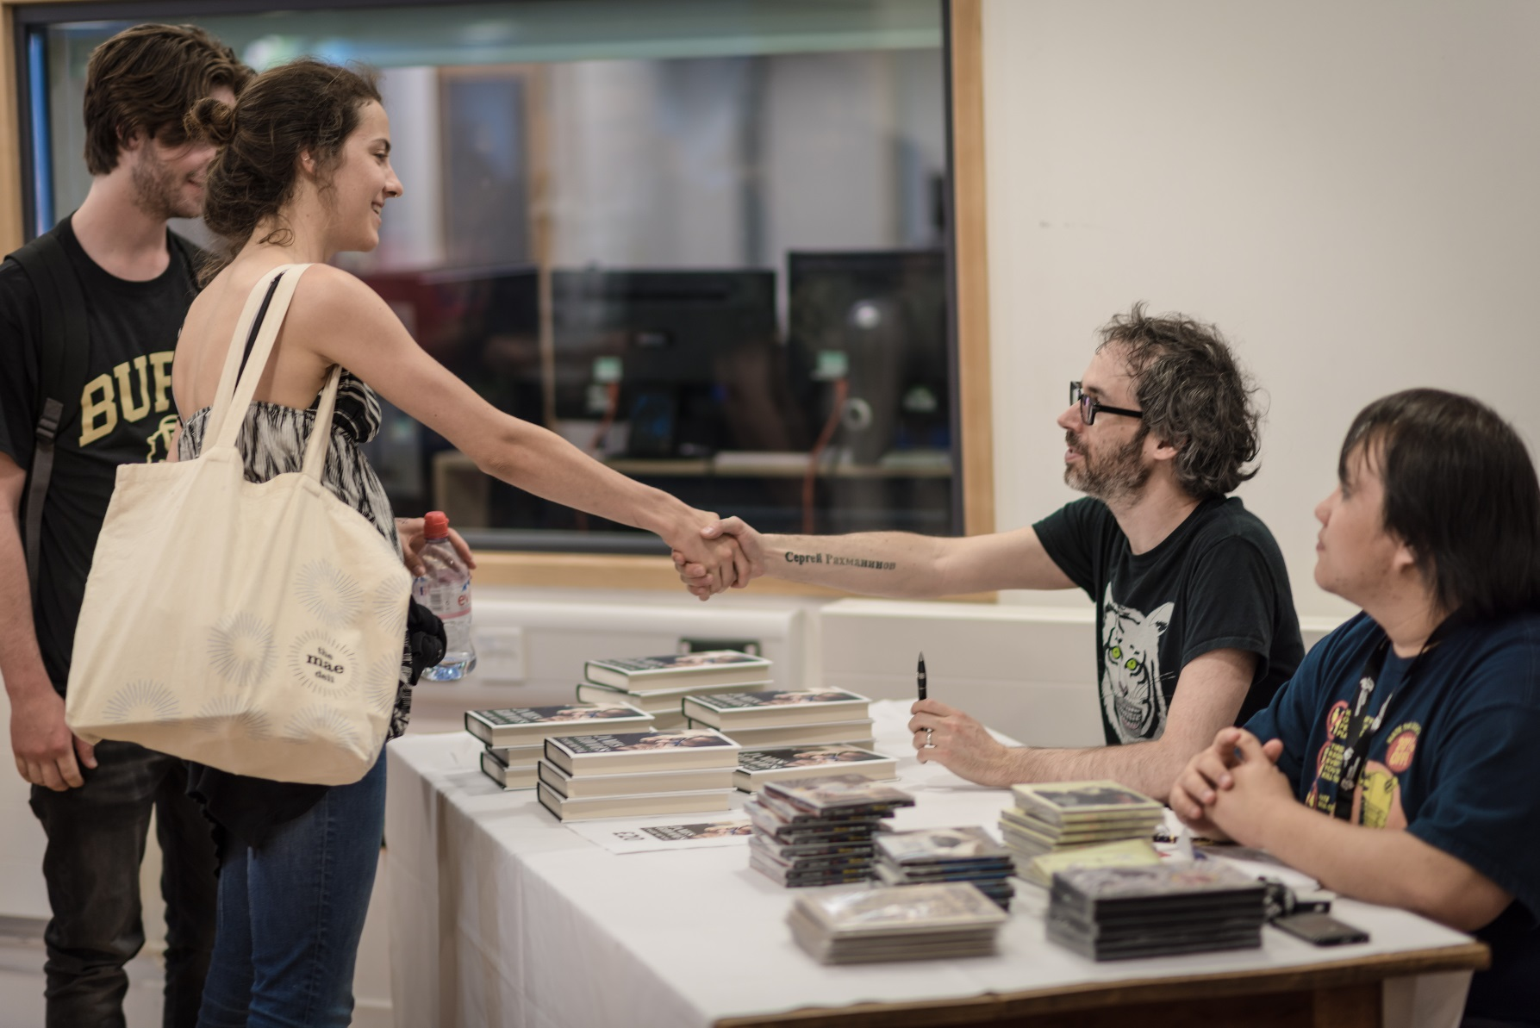
Artists, performers, inspirational speakers
Special events

Slide 12
Why students want to do GC
To improve employability skills
To experience relevance of University learning to the outside world
They feel passionate about the topic
To meet other students
To work in an interdisciplinary way

Slide 13
What students enjoyed
Working in a like-minded team of people passionate about the same topic
Being in control of the direction of their output
The interdisciplinary nature of their group
Learning new things and developing new skills
Exploring a topic outside of their discipline
Interacting with external speakers
Meeting new people

Slide 14
Impact
Students reported being more motivated to:
Change their behaviour in relation to the topic;
Engage in additional activities to further improve employability skills.
Students improved their
Skills: teamwork, communication, public speaking
Confidence;
Awareness of the positives of interdisciplinary working.

Slide 15
Video
You can see our short promotional video on:
https://www.exeter.ac.uk/grandchallenges/

Slide 16
What did other participants think?
“The level of interest and engagement with the students was excellent and beyond my expectations.” An external collaborator
“My interdisciplinary skills are much developed, and I really enjoyed the week.” A postgraduate facilitator

Slide 17
“The students were SO engaged. I have rarely seen such engaged students - they worked through lunch! Their outputs were brilliant and there was a wonderful, cohesive and supportive atmosphere/community.” An academic
“Opportunity to interact with students in an environment free of assessments where they can show creativity.” An academics

Slide 18
