Slide 1

EHOD Skills Plan – Evidence Base
Ben Neild
Notes:
Look at changes in the economy in the area… Demand for Skills

Slide 2

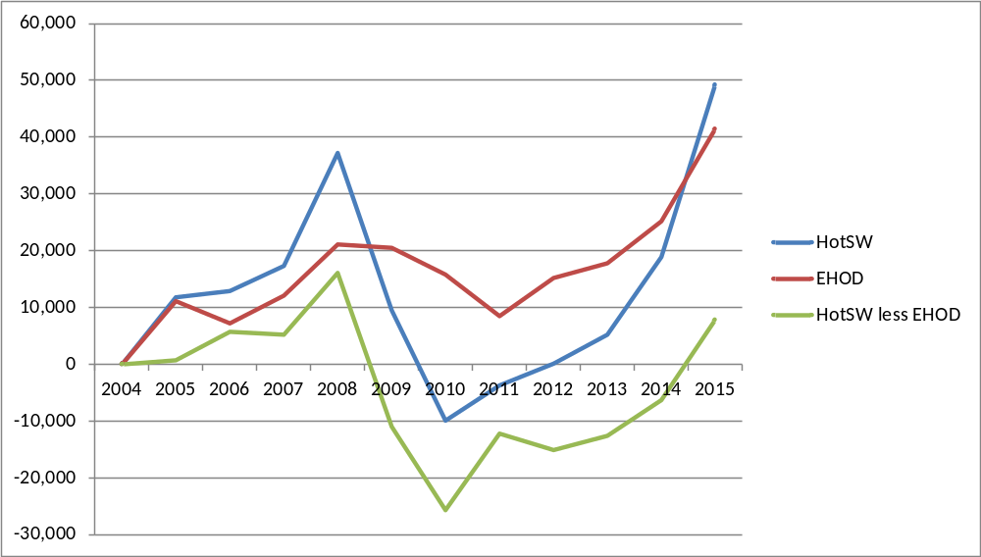
Change in employment,16-64 year olds, workplace
Notes:
In 2014, 218,000 people employed in EHOD - 11% more than a decade earlier.
Nationally employment grew by 6%
HotSW it grew by just 3%.
Huge issue about Economic Development…. Surging or lagging areas????

Slide 3
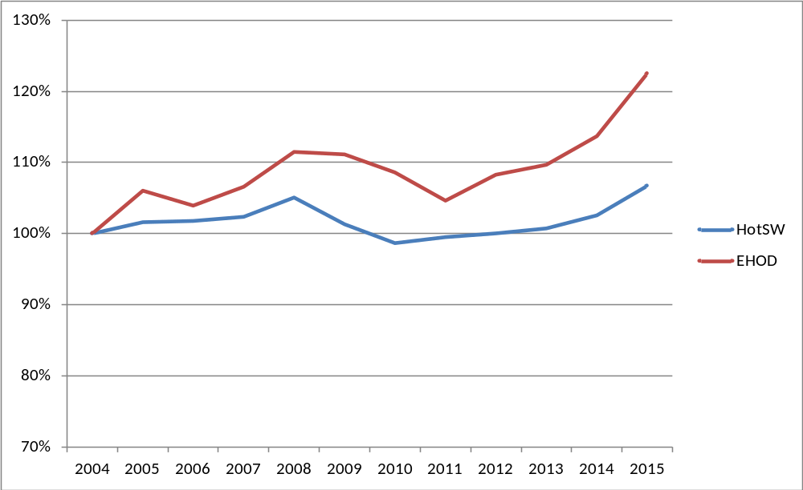
% change in employment,16-64 year olds, workplace
Notes:
In 2014, 218,000 people employed in EHOD - 11% more than a decade earlier.
Nationally employment grew by 6%
HotSW it grew by just 3%.
Huge issue about Economic Development…. Surging or lagging areas????

Slide 4
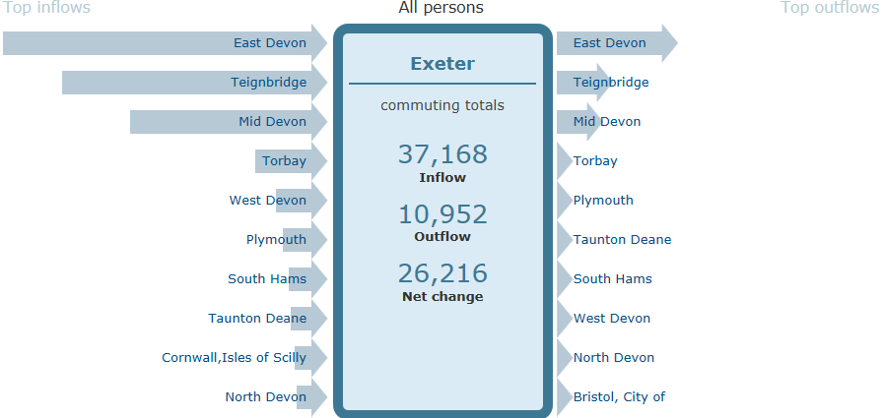
Travel to work flows
Notes:
Third largest after Cambridge & Crawley

Slide 5

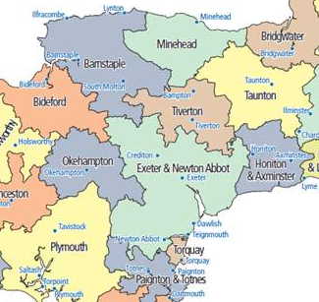
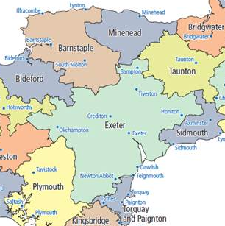
2001
2011
Travel to work areas

Slide 6
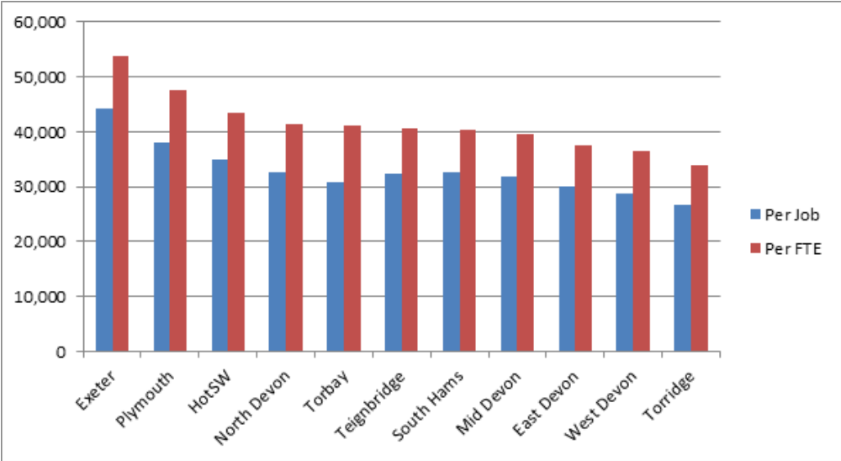
Productivity (GVA) per job and per FTE, 2015
Source: Oxford Economics / HotSW LEP Economic Model
Notes:
Drawn to more productive / better paid employment from surrounding areas

Slide 7
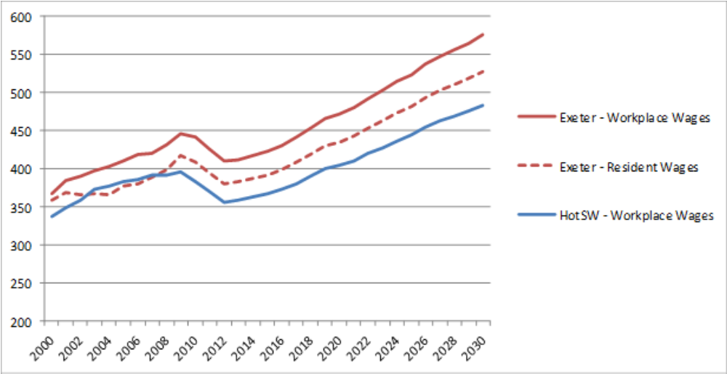
Workplace wages (£ per week, 2009 prices)
Notes:
Relationship to wages
Workplace wages rising faster than resident wages… gap widening.
….benefit of growth felt by commuters more than residents.
How do you connect people to results of local growth
Apprenticeships are an important part of that equation

Slide 8

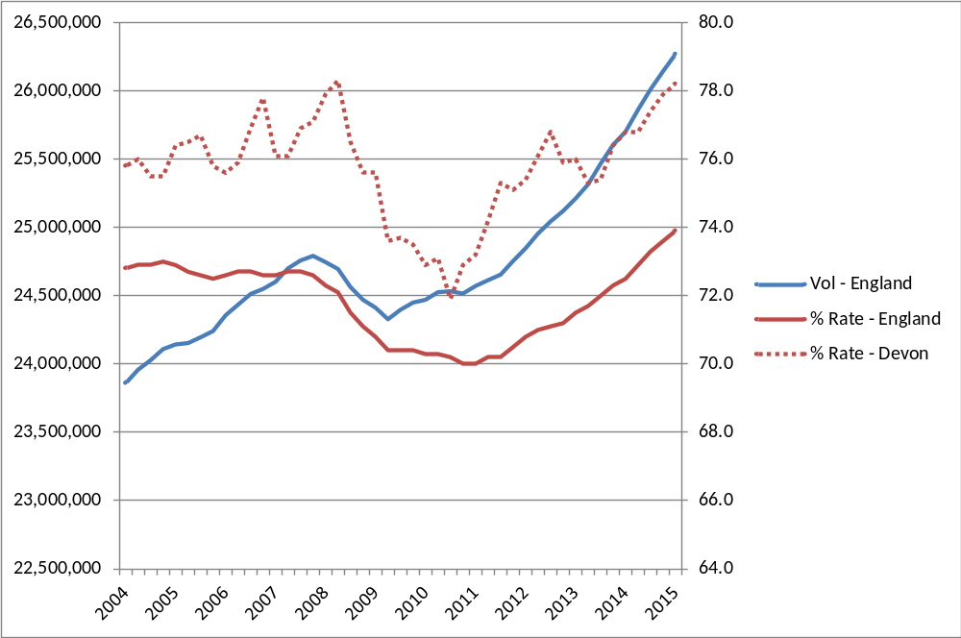
The labour market is tightening
Notes:
Impressive increase in both..vol and % employment
Devon v. high rates. 80% pretty much seen as a natural limit.

Slide 9
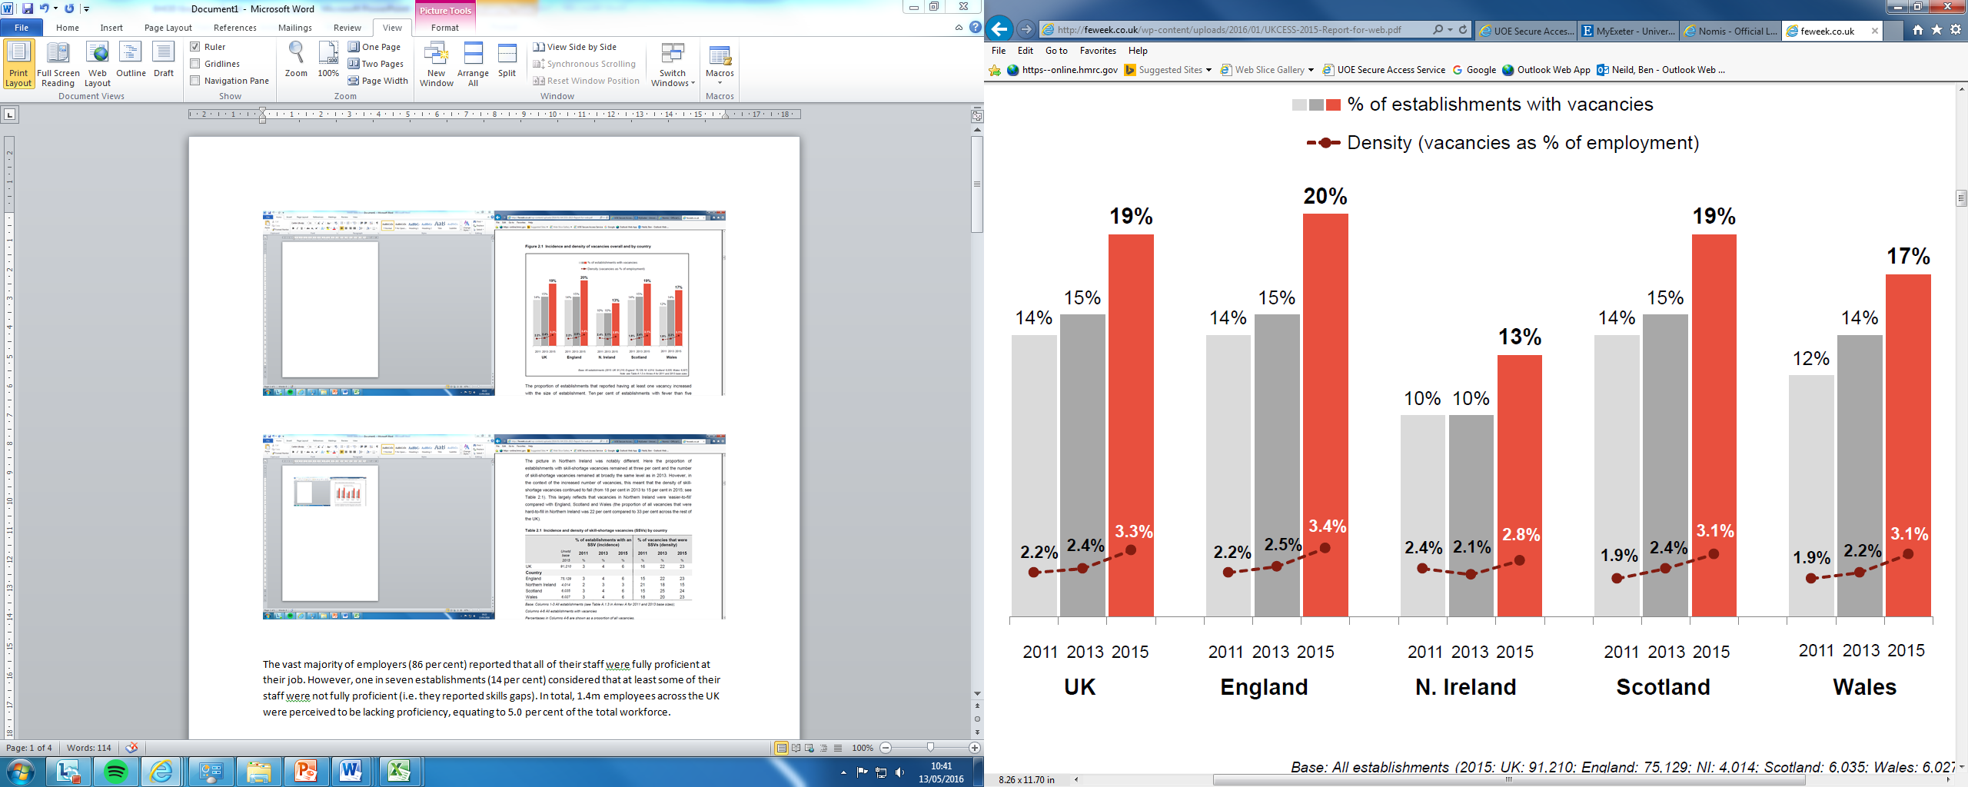
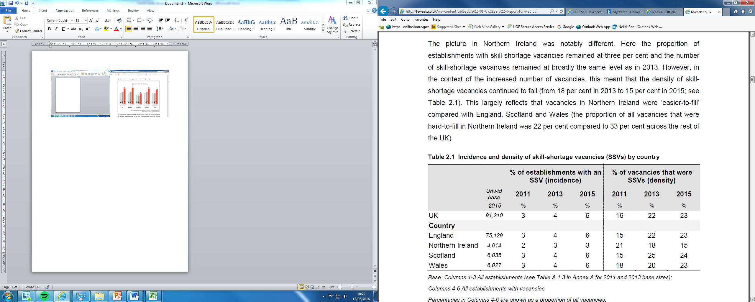
Consequences of a tight labour market
The number of unfilled vacancies is growing
A growing number of employers have vacancies they can’t fill because they can’t find candidates with the right skills
Source: National Employer
Skills Survey 2015

Slide 10
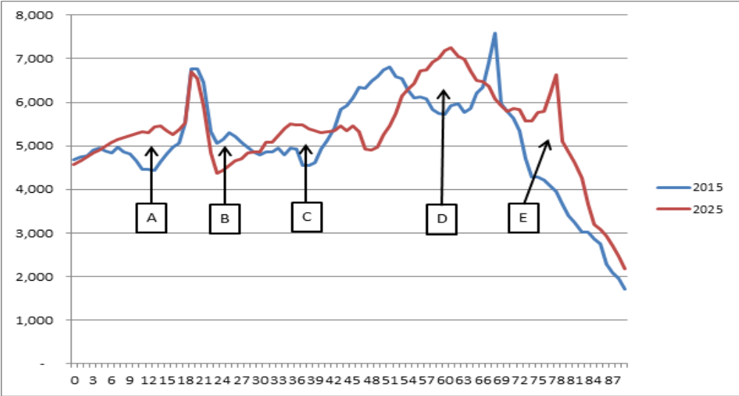
Population change, 2015 - 2025
A - Increase in young people of primary and secondary school age
B - Fall in no. of young people leaving education & entering work
C - Moderate increase in the number of 30 to 40 year olds
D - Significant rise in 54 to 66 (who may need up-skilling/re-skilling)
E – Significant growth in the number of people over retirement age

Slide 11

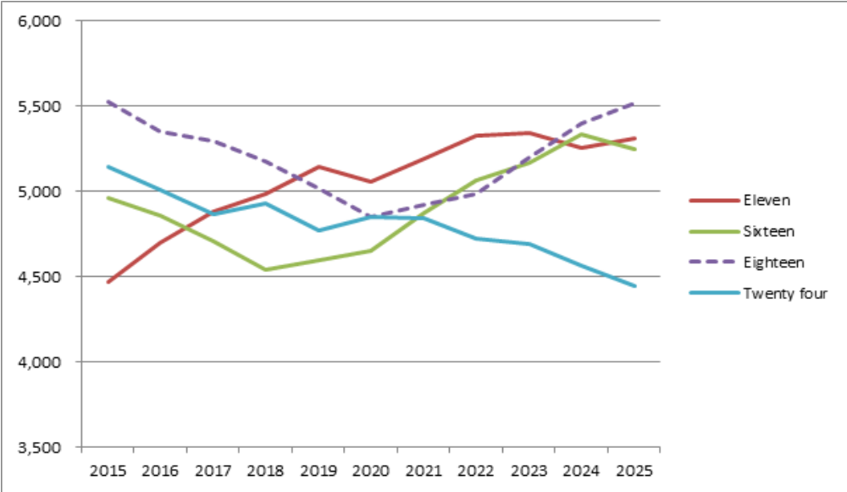
Young people entering / leaving education,
training & the labour market, HotSW
Notes:
Number of 11 year olds is projected to rise, and rise significantly… primary school expansion..
Flows through to sixteen year olds from 2018. Falls for next couple of years, dramatically
University entrance at eighteen… purple dotted… will be struggling to maintain numbers to 2020.
And 24 years… goes on falling over the entire period. In 2025 will be 15% fewer. Won’t be a bad time to be leaving university!

Slide 12

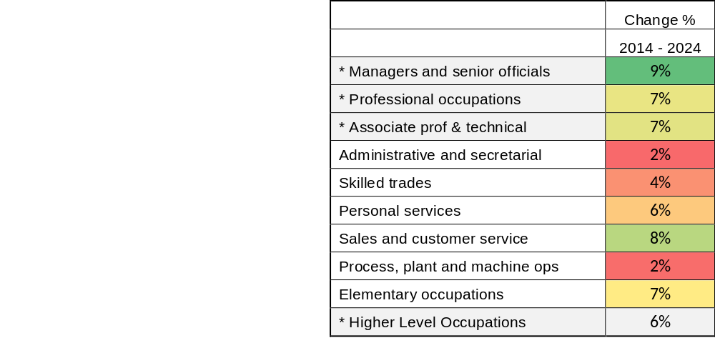
Projected employment growth by occupation
Employment is projected to continue to become increasingly knowledge intensive.
Though demand for Sales / customer service staff & Elementary occupations is also high

Slide 13
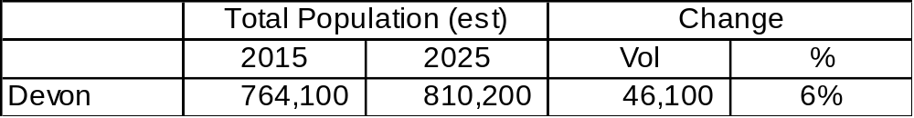
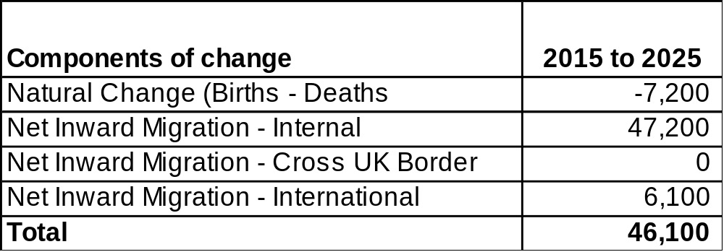
Projected population growth & its components
Looking forward population / employment growth is expected to continue, mainly driven by internal migration.
Notes:
Nicking Jobs – is people like me you want to blame.
Not an economic thing really… There isn’t a debate about the economic impact of internal migration. It’s just accepted. it’s an identity thing.
Actually matters… because creating opportunities for local people / young people to find work in their local economy matters.

Slide 14
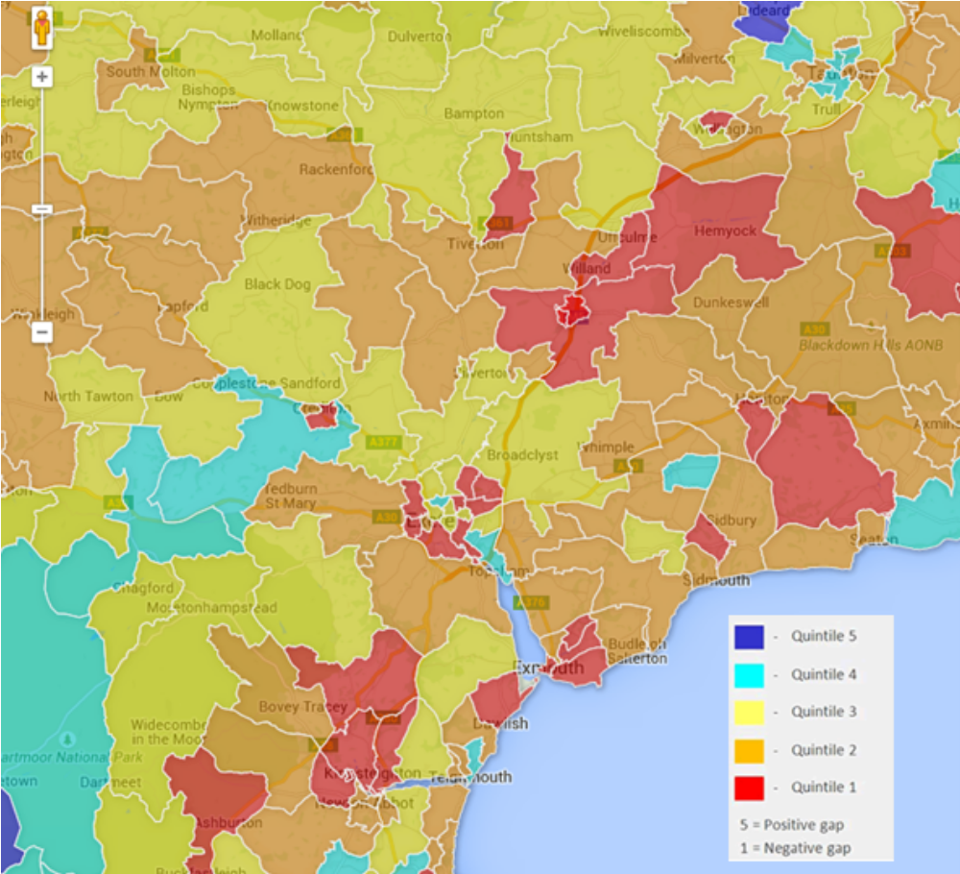
HE Participation
Relative to expectations based on educational attainment, the proportion of young people who progress to higher education from much of the local area is low.
Notes:
Whole of the SW is pretty orange and red… widening participation / raising aspirations is an issue.

Slide 15

Apprenticeships have a crucial role in
Ensuring local people benefit from local employment growth
Addressing expected tightening of labour market and growth in recruitment difficulties
Training / retraining of an older population, in response to structural change
Raising low levels HE participation (particularly among white working class boys)
Supporting systematic approaches to staff development and training

Slide 16
Thank You
Contact us: Ben Neild
b.neild@exeter.ac.uk
01392 264823

