Slide 1


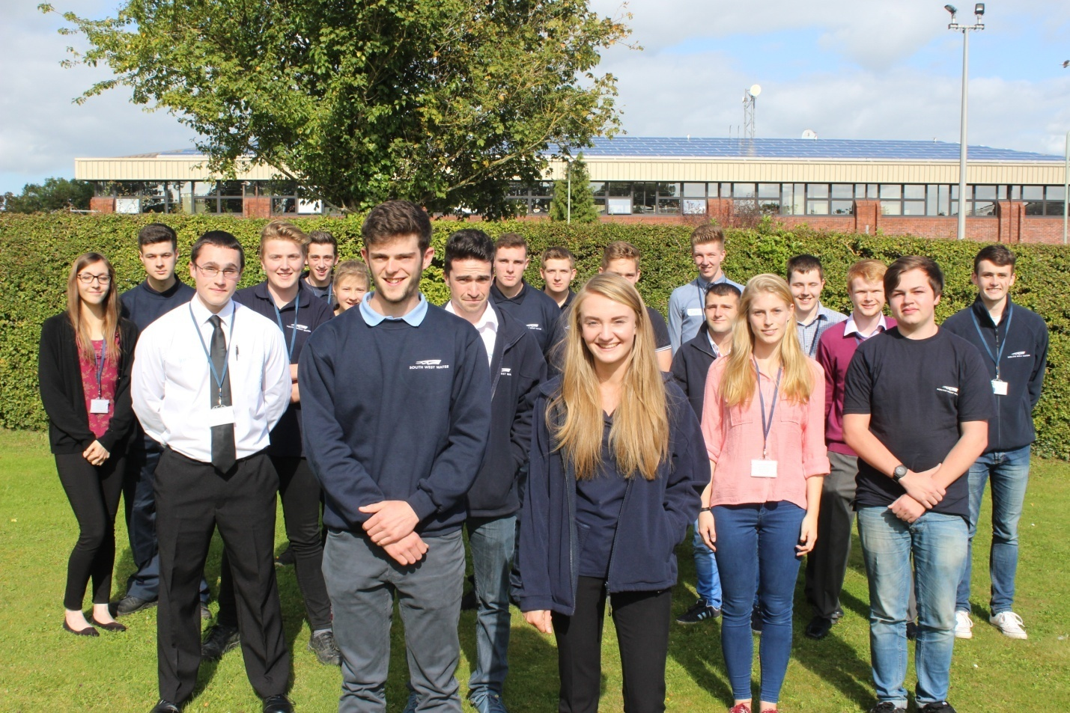

South West Water Apprentice Class of 2015!
Notes:
These are some of the 21 apprentices we recruited during spring and summer of 2015

Slide 2
SWW Apprenticeships –
The story so far
Established programme introduced in 2011
First cohort of 16 Operations apprentices
Over last 5 years number of apprentices has risen to c85 (17 female)
Apprentices now work in 15 operational and business support disciplines
5% of our workforce is made up of apprentices
83% of our Operations apprentices have been offered permanent roles
Apprenticeships now form part of our business planning cycle
Notes:
In 2010 we identified a serious skills gap with 40% of our operational employees likely to retire within 10 years.
SWW introduced apprentices the following year as part of its strategic plan to develop a skilled and qualified workforce and address succession planning so we can sustain delivery of quality services and compete in an increasingly competitive market.
Over the last 5 years we have expanded our programme and of our 1300 workforce we now boast 5% of our employee base as either current or graduating apprentices

Slide 3
SWW Apprenticeships –
our successes
SWW is one of the UK Top 100 Apprenticeship Employers for the second year in a row
SWW won Large Employer of Year in National Apprenticeship Service SW Awards 2015
SWW Business Excellence Apprenticeship Employer of Year in Devon
A number of our apprentices have been recognised as outstanding students by the Colleges they attend
Nigel Fenn chairs a regional group of employers who champion the cause of Apprenticeships within their business networks
SWW is playing a pro-active part in the reform of Apprenticeships within the water industry
Notes:
Five years on, with 85 current and graduating apprentices supporting 15 different departments, we have discovered a well-organised apprenticeship programme has multiple benefits.
Our apprentices bring so much to the business: with a significant cohort of young people now embedded throughout the company, their tech-savvy approach is significantly improving knowledge-flow and cultural differences

Slide 4

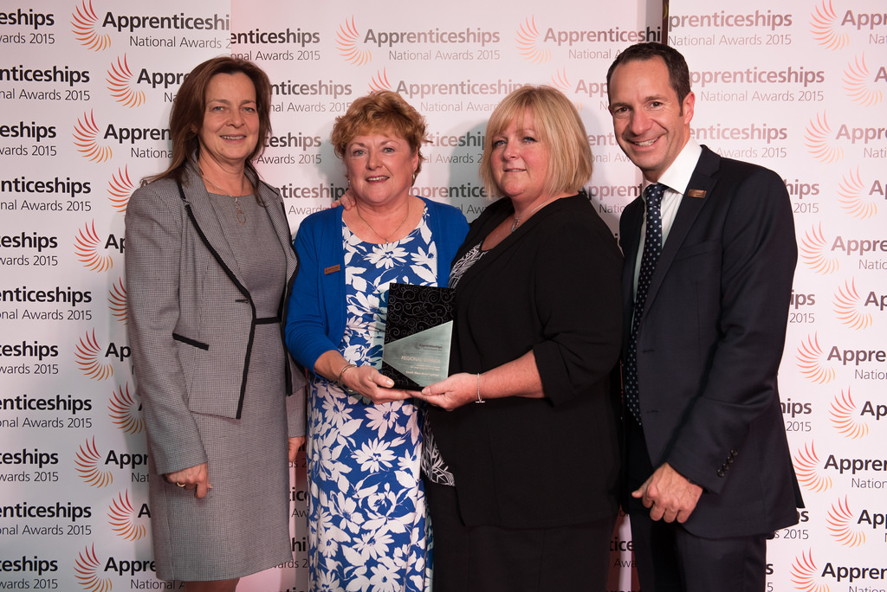
South West Water receive SW Regional
Large Employer of Year at
National Apprenticeship Awards 2015
Notes:
Forgot to include our achievement last year as Regional Large Employer of the year in South West. Unfortunately we didn’t win nationally but we are listed as a Top 100 Employer of Apprentices for the second year running.

Slide 5
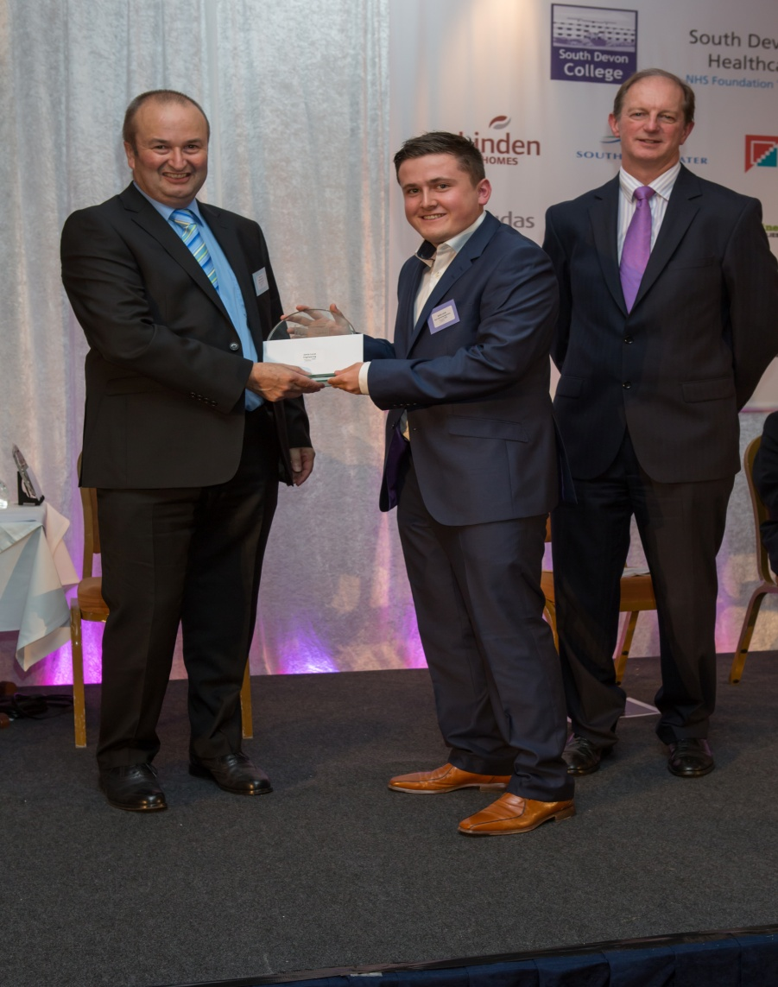
Jamie Lucas receiving the South Devon College
Engineering Apprentice of the Year award 2014
Notes:
A number of our apprentices have been recognised as outstanding students by the Colleges they attend.
Jamie progressed to Higher Apprenticeships.

Slide 6
How did we get here?
Business Partnership
Apprenticeship Structure (number of Training Providers and delivery methods to suit the role and location)
Building on our strengths
Links with SFA, EU Skills, Training Providers and Government
Mentor programme
Apprenticeship Community A Team
Listening to the business, understanding their needs and taking a flexible approach
Notes:
South West Water’s story is remarkable because of the journey made and lessons we have learned.
We have developed business partnerships in our community. With a number of Training Providers to deliver the apprenticeships our business needs. Also with our partnership of the South Devon UTC to generate our future pipeline of apprentices and graduates.
We have adopted an accredited programme to support our mentors.
We also have a flourishing apprenticeship community who meet regularly and use facebook to communicate
Apprentices are influencing our communications strategy by championing social media, changing the way we communicate with customers. Social media staged our 2015 recruitment drive to attract 21 new apprentices. This strategy has improved female applications from 5% to 25% in four years.

Slide 7
Where do we go from here?
Stimulating new Apprenticeship growth via our supply chain
Membership SW Apprenticeship Ambassador Network
Having the right intelligence to make informed choices to maximise opportunities created by Apprenticeship Reforms
Progression to Higher Education and Management roles for our current and graduating apprentices
100 apprentices through programme by 2016/17
Notes:
Continue to work closely with Govt and contribute to App Reforms as well as our plans to maximise every opportunity to make best use of employer levy being introduced next April
Continue to share best practice with the SWAAN which has 45 employer members and chaired by Nigel Fenn
Encourage our supply chain and target our sister companies
Grow our own programme in different ways: We have concentrated in getting our apps programme embedded in SWW. Now we are ready to move on to look at other business reqts requiring higher level skills. So far we have 7 apprentices in our finance dept who are all working towards a Higher Level accountancy qualification. Also for the first time last year we have progressed a couple of graduating apprentices in Electrical Engineering. This year we are looking at both HAs in Project Management and Degree Apps in IT and Leadership and Management. We will be going to market externally to find these young people in our community.
SWW is a great example of a company who adopted apprenticeships for a defined business reason (to mitigate the risk or our ageing workforce) but now recognise the multitude of benefits a successful programme can bring.

Slide 8
Apprenticeship Levy
Costs
Probable Expenditure
South West Water levy £170,000
Pennon Group levy
£700,000
South West Water based on 40 apprentices in training (all ages)
£140,000 expenditure could be offset against SWW levy costs
Pennon Group currently have c30 apprentices in other 5 companies
Notes:
20 operational apprentices attracting £15000 funding over 3 years = £300,000. £100,000 for each year
20 business support apprentices attracting £4000 funding over 2 years = £80,000. £40,000 for each year
£140,000 estimated income to South West Water, using current funding rates (not new Levy caps) and
*ignoring age and employer contributions to training

Slide 9
Employer Opportunities with Apprenticeship Levy
Putting employers in the driving seat for creating Apprenticeships that fully meet our business needs
Funding can increase for our existing Apprenticeship provision via employer incentive payments if we recruit 16 – 18 years and on successful completion
More partnership opportunities within our supply chain and other Levy paying employers
Potential to develop employer buying group to negotiate with Training Providers to ensure we get what we want
Notes:
Levy is the next step in Government reforms to create sufficient budget to support boosting our nation’s productivity and raising skills levels via Apprenticeships – the Levy will raise £3bn by 2020.
As with earlier Apprenticeship reforms, Government putting a lot of the decision making in employers hands.
From April 2017 onwards, we will make decisions about taking on apprentices – and be given incentives for starts, successful completions and if we recruit 16 – 18 years
We will have greater purchasing power and oversight of providers available
* Details still sketchy in terms of funding rules for Apprenticeship Levy

Slide 10
Employer Challenges with Apprenticeship Levy
Slow development of Apprenticeship Standards
Information slow to emerge from Skills Funding Agency about changes ahead
Adoption of different models of Apprenticeship delivery and where support will come from
Management of significant income/expenditure stream via HMRC, Provider Network and Skills Funding Agency
Getting buy in from wider Group of companies
Higher levels of bureaucracy – not our day job!
Notes:
Limited number of standards available for delivery and even less Training Providers who have yet to adopt them
Apprenticeship Levy being introduced at a time of great change within Skills Funding Agency – restructure, less regional capacity to support and underpin our knowledge
Uncertainty about new standards and how model of delivery will work, particularly end point assessments
How we manage the Levy process – by Group or individual Group members – HR, Payroll and Training involvement – time, resource, system knowledge, Levy teething problems
All within a frighteningly short timescale

Slide 11
Question Time

