Slide 1

EHOD Skills Plan – Evidence Base
Ben Neild

Slide 2

Economy
Slides on the Economy present a picture of:
Rapid local employment growth
Tightening labour market locally and nationally
Growth in unfilled vacancies & skills shortage vacancies
Benefits of growth that are not being shared by local residents

Slide 3
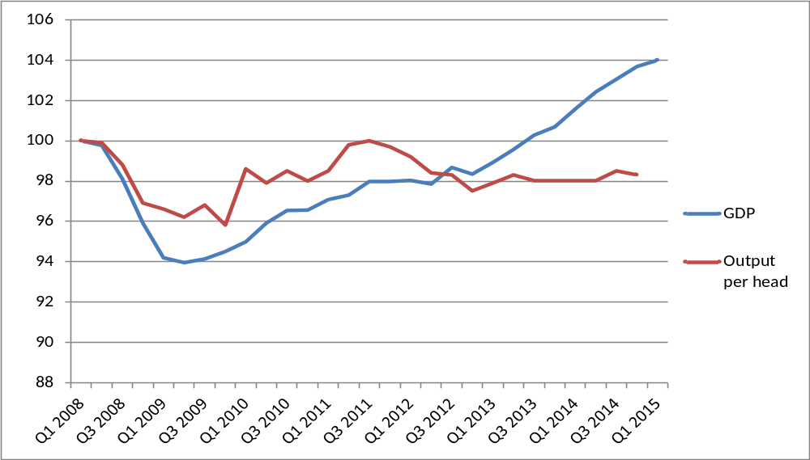
Productivity
GDP is rising, but as a result of employment growth. Output per head is lower than before the crash. Wages & standards of living are not rising as they should.
GDP & Output per head, constant prices, Q1 2008 = 100
Notes:
According to ONS UK output per hour in 2014 was 20% below the average for the rest of the major G7 advanced economies - the widest productivity gap since estimates began in 1991.
Skills are a key driver of productivity.

Slide 4


Time off to train
Number of employees working fewer hours because of training
Notes:
Consistent and dramatic decline. Annual Population Survey… individuals are asked if they’ve been trained.

Slide 5

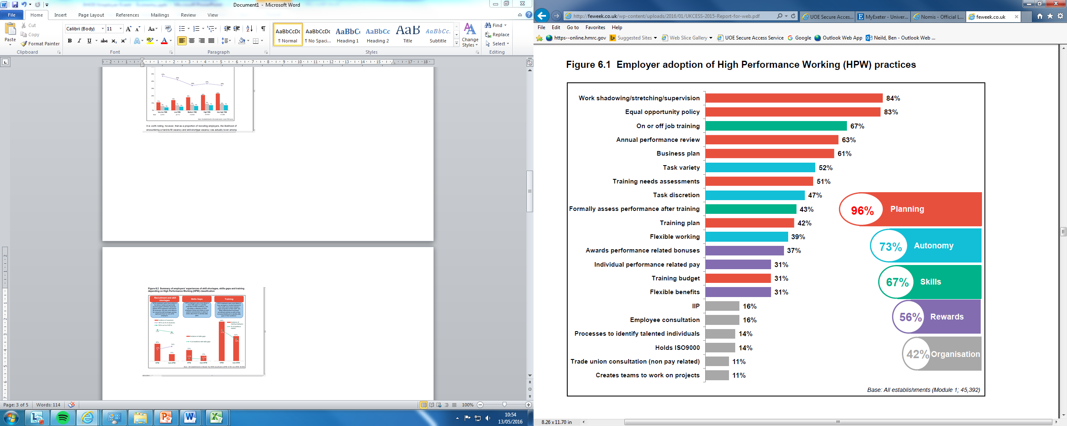
% Employers adopting High Performance Working Practices

Slide 6
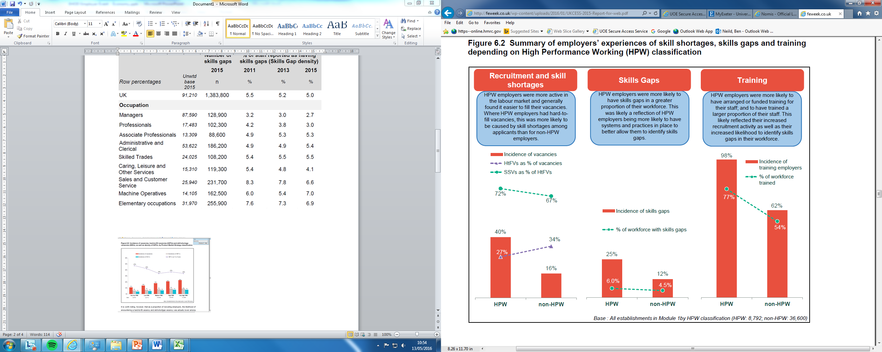
High Performance Working

Slide 7
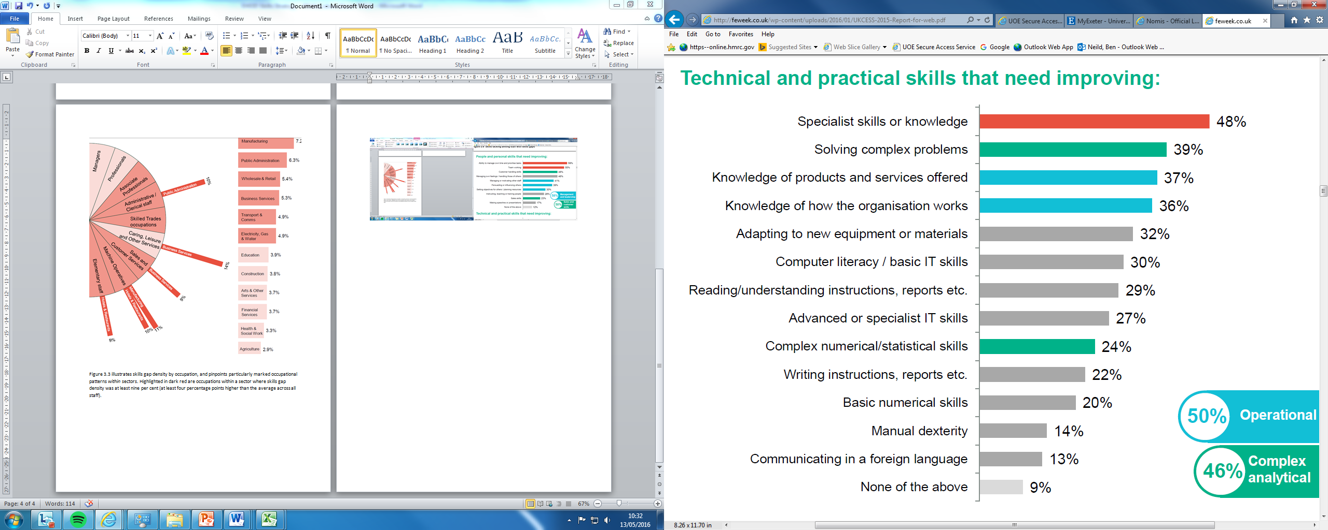
Skills Gaps
Notes:
Again… many of these can only be learned on the job.
Not many academic ones.

Slide 8
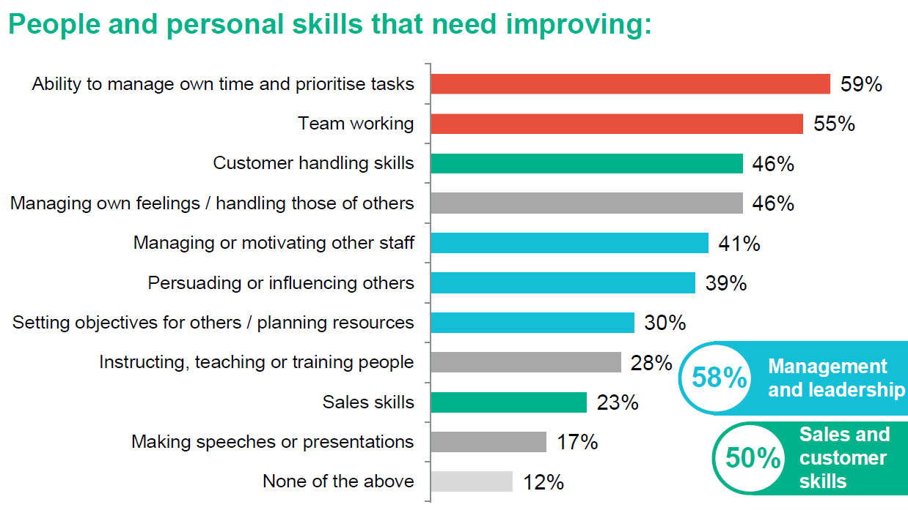
Skills Gaps
Notes:
Many relate to adoption of behaviours and attitudes etc
…. Only acquired as a result of being in work
…. Begs the question of what do we mean by ‘learning’ … Wenger and Lave….

Slide 9

Degree Apprenticeships – University view
Degree Apprenticeships should open a choice for young people, between:
The traditional route to a degree - full-time academic learning, an engaging ‘student experience’, graduation with an average debt of £44,000, enhanced employment prospects but no immediate job;
An Apprenticeship route to the same qualification, acquired free of debt over four or five years of earning while learning with the prospect of continued employment post-graduation.
Degree Apprenticeships may prove an attractive proposition for:
a cohort of ambitious and capable students with good A level results;
young people from the region with good results who do not progress to Exeter or any HEI.
A genuine opportunity to create a vocational pathway that is held in something like ‘parity of esteem’ with the academic route.
Population Profile, England, 2015
Notes:
9

Slide 10
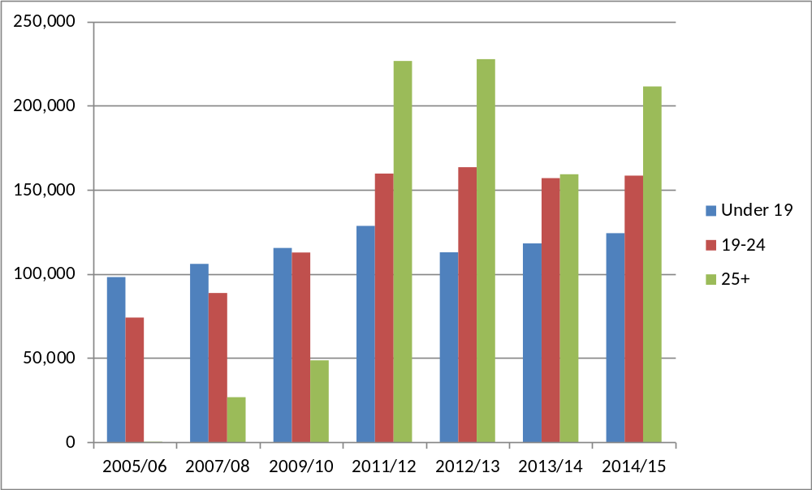
Apprenticeships
A common misconception is that Apprenticeships are a route for employing / upskilling young people. In reality, growth has mainly been achieved by increasing the number of adult apprenticeships. The number young people starting Apprenticeships (the ‘Dual-system’ model) has changed little over the years.
Apprenticeship Starts by Age (England)
Notes:
10

Slide 11

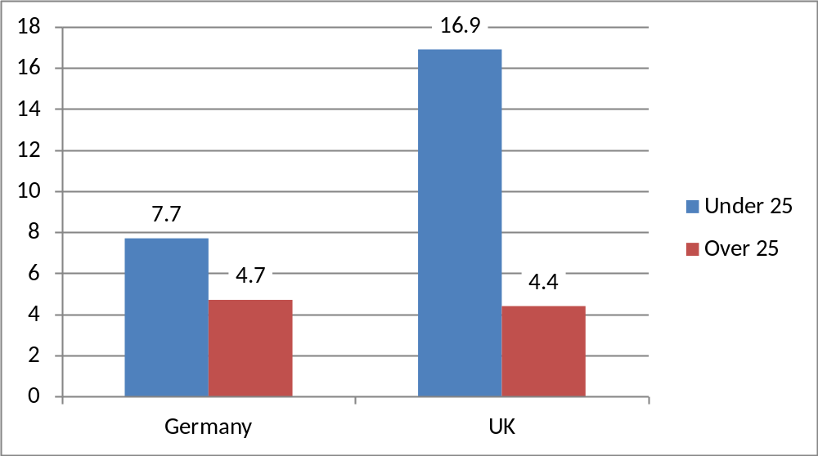
Dual System
In Germany nearly 50% of young people enter the ‘Dual System’, acquiring skills/qualifications at Level 3 qualifications and above . This supported transition from education to the labour market reduces the differential between rates of youth and adult unemployment and provides essential intermediate, technical level skills.
Youth v. Adult Unemployment, Germany & UK, 2014
In 2011, of 33 OECD countries, the UK was ranked 19th for low skills, 24th for intermediate skills, and 11th for high skills.
Labour Market Story: the State of UK Skills
UKCES, March 2011
“In Austria, Germany and Switzerland around one in four employers offer apprenticeships. In England fewer than one in ten do. That's got to change.”
George Osborne, Budget Speech
March 2011
Source: Eurostat
Notes:
Wider Societal benefit

Slide 12
Apprenticeships
Apprenticeships provide an opportunity and incentive to review and systematise
Recruitment practices
Staff development and progression opportunities
They offer the opportunity to be demanding of training providers (like Exeter University & Exeter College) setting out your needs, though providers still need to assess the likely demand cost-effectiveness.
Enables you to reach out into Schools, working in partnership with Colleges / Providers
To address issues of staff turn-over, in context of tightening labour market.
Population Profile, England, 2015
Notes:
12

Slide 13

Thank You
Contact us: Ben Neild
b.neild@exeter.ac.uk
01392 264823

