Slide 1

Exeter and Heart of Devon ESB (25/05/16)
Briefing:
“Ready for the Apprenticeship Levy and targets in the Public Sector 2017”
Richard Daulton
National Apprenticeship Service

Slide 2


The Levy is part of a broader programme of reforms
Government committed to reach 3 million apprenticeship starts by 2020.
Building on apprenticeship benefits and impact. Productivity
Step changes in scale, scope, quality and funding of apprenticeships required
Reforms aspects:
Public sector bodies – setting new apprenticeships duty/targets via the Enterprise Act.
New Institute for Apprenticeships
Digital Apprenticeship Service (includes Levy payment mechanism)
Apprenticeships Standards (employer led)
Abolishing employer national insurance contributions for apprentices under the age of 25 from April 2016
Notes:
Queen’s speech: 3rd sentence apps and economic growth and legislation to support

Slide 3
Apprenticeship targets – public sector
Enterprise Act (4th May 2016) – Sec. of State power to set targets
Apprenticeship targets for public sector (consultation outcome pending)
Target = 2.3% of headcount annually as apprenticeships starts (new recruits/existing staff)
Duty (England only) to report progress towards meeting target
Regulations will set out public bodies in scope (refer Office for National Statistics) and with >250 employees
e.g. local government, schools (non LA), fire and rescue, police, armed forces, govt. agencies, NHS, ministerial and non-ministerial depts., public sector bodies
;

Slide 4
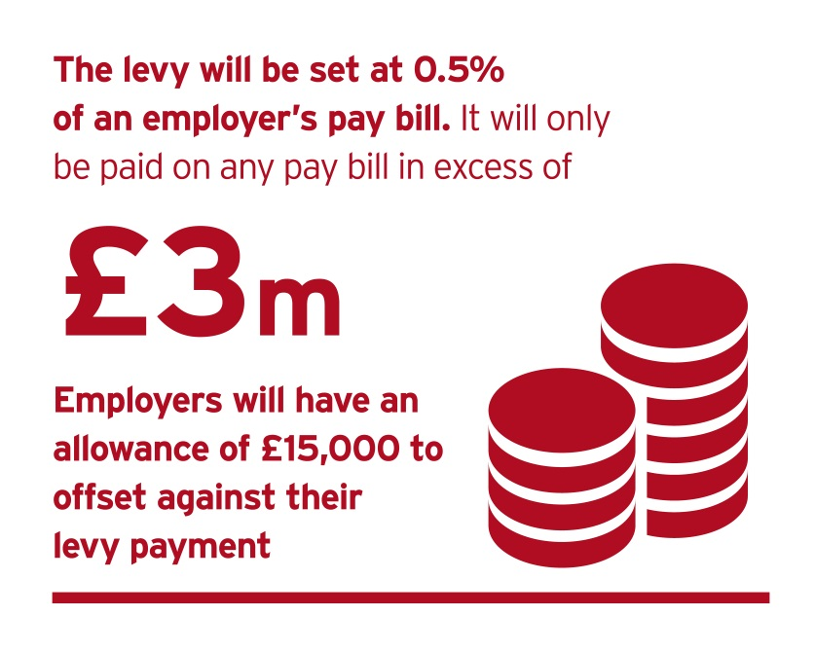
Levy impact
Effective 6th April 2017
levy will be 0.5% of annual pay bill paid through PAYE.
All employers operating in the UK, all sectors including public, with a pay bill of more than £3 million per year liable to pay the levy
levy offset allowance of £15,000
Employers in England who pay the levy and are committed to apprenticeship training will be able to get out more than they pay into the levy
Notes:
Misconception: the £15,000 is not a ring-fenced amount. It is an allowance. It only relates to the payment side.

Slide 5
Levy account – employer use of funds
Use for apprenticeship training and assessment (with approved training/assessment organisation) up to a funding band maximum. Draft funding bands in June 2016.
Cannot use for: wages, travel, management costs, set up etc.
Apprentices who have been accepted on to an apprenticeship before April 2017 will be funded for the full duration of the apprenticeship under the conditions that were in place at the time their apprenticeship started.
Notes:
What you can use funds for
apprenticeship training and assessment
(with an approved training provider and assessment organisation up to its funding band maximum)
What you cannot use funds for
wages
statutory licences to practise
travel and subsidiary costs
managerial costs
traineeships
work placement programmes
the costs of setting up an apprenticeship programme
An apprenticeship requires substantial and sustained training, lasting a minimum of 12 months and involving at least 20% off-the-job training.

Slide 6
Levy payment examples
Employer of 270 employees, each with a gross salary of £20,000
Pay bill = £5,400,000
Levy sum: 0.5% x £5,400,000 = £27,000
Allowance: £27,000 - £15,000 = £12,000 annual levy payment (digital account)
Employer of 100 employees, each with a gross salary of £20,000
Pay bill: = £2,000,000
Levy sum: 0.5% x £2,000,000 = £10,000
Allowance: £10,000 - £15,000 = £0 annual levy payment
Notes:
How?
You will calculate, report and pay your levy to HMRC, through the Pay as You Earn (PAYE) process alongside tax and National Insurance
Operators of multiple PAYE schemes will only have one allowance
Connected employers - only one of the employers in a group can use the allowance
You won’t be exempt from the apprenticeship levy if you already pay into an existing levy

Slide 7
Levy account top up
The government will apply a 10% top-up funds entering levy paying employers digital accounts, for apprenticeship training in England, from April 2017.
Employer £12,000 annually entering their levy account
Top up: 10% x £12,000 = £1,200
Employer has £13,200 annually to spend on Apprenticeships
Worked example

Slide 8
Apprenticeships funding bands – how they work
THE FUNDING BAND LIMIT
Draft funding bands for 2017 (Standards and Frameworks) due June 2016.
Example:
Maximum of funding band = £6,000
Price employer negotiates with your training provider = £5,000
The cost is within the maximum funding band limit
£5,000 will be deducted from the employer’s levy account over the life of the apprenticeship.

Slide 9
Apprenticeship funding - Extra support
16-18 year olds (paid to employer by training provider – not from levy account)
Funding for additional needs
Funding for English and maths training
Notes:
16-18 year olds
Payment to help meet the additional costs associated with employing young apprentices. This will be paid to you through the training provider.
Details on the size and timing of this payment will be announced provisionally in June and finalised in Autumn 2016.
Funding for additional needs
Learning support will be available as now via providers (similar cost)
Core learners who declare will be eligible for employer payments as per 16/18 in centre payment.
Funding for English and maths training
If your apprentice doesn’t already have them they may need to undertake an English and/or Maths course to get to level 2
We will pay providers directly for the English and Maths courses they offer.

Slide 10
Levy mechanism – levy paying employers
10% Top up
HMRC collect levy (PAYE)
Employer views levy funds in digital account
Employs Apprentice. Commits to training
Receives training for apprentice
SFA draws down levy funds monthly
Unused levy funds expire after 18 months
Employer
Our objectives: Employer control and simplicity
Training
Provider
Registers with SFA
Offers apprenticeship training
Provides training to apprentice
Provides monthly ILR
Paid by SFA
Pass data on levy payments from HMRC to BIS
Timely data on training
Check training is complete
If funding unlocked: Pay provider
Government
Employer and Provider Identity Assurance
Our objectives: Get the machinery right to provide a quality service while protecting public purse

Slide 11
Apprenticeship levy and funding: further detail and timescales
Summer 2016
Autumn 2016
End 2016/
early 2017
April 2017
High Level Scope
Operating Detail
Transition
Operation
April 16:
BIS/DfE - Employer Guide (operating model for levy)
May 16: Enterprise Act and Finance Bill Royal assent
June 16:
BIS/DfE draft funding bands & maxima for April 17.
October 16:
BIS/DfE publish
final funding levels, govt. support, extra payments SFA publish draft funding rules
Digital Apprenticeship Service (DAS) registration.
December 16:
Final funding & eligibility rules.
HMRC Levy calculation and payment guidance.
January 17:
Employer register to set up levy a/c in DAS.
  Digital apprenticeship service operational – levy accounts (May’17)
  Funding and eligibility rules live
  Institute for Apprenticeships
  New industry training board (ITB) levy orders in effect

Slide 12
Digital Apprenticeship Service

Slide 13
What is the digital apprenticeship service?
The digital apprenticeship service comprises several aspects:
The digital apprenticeship service programme
Find an apprenticeship
(current)
Search for a standard/framework and provider
(Oct’16)
Recruit an apprentice
(Oct ’16)
Manage funding and levy account
(Jan’17)
Provider readiness
Employer readiness
Notes:
13
Shows the elements of the service as they will be accessed by employers.
Find an apprenticeship is green because it has been built and you can see it – the other parts are not public yet.
The search element is being piloted in 2 sectors – automotive and IT/digital because they have standards and frameworks in place. Providers will upload their data and employers will test the initial search capability as users.
Changes and improvements will be made based on their feedback. The core capability of the search will enable employers to find a standard/framework and a provider (Slides 14-17 illustrate this so this info can be given then if desired).
The data entry tool is currently being tested by SFA advisory groups. Early feedback is that the data entry is quick and simple.
The register/account part will be built by working with HMRC so that they pass over the data about what levy has been paid via PAYE so it can appear in the digital apprenticeship service. Registration for this part must be secure. (other parts of the digital apprenticeship service won’t require that level to browse information). There will also be user roles with different levels of access to information.

Slide 14
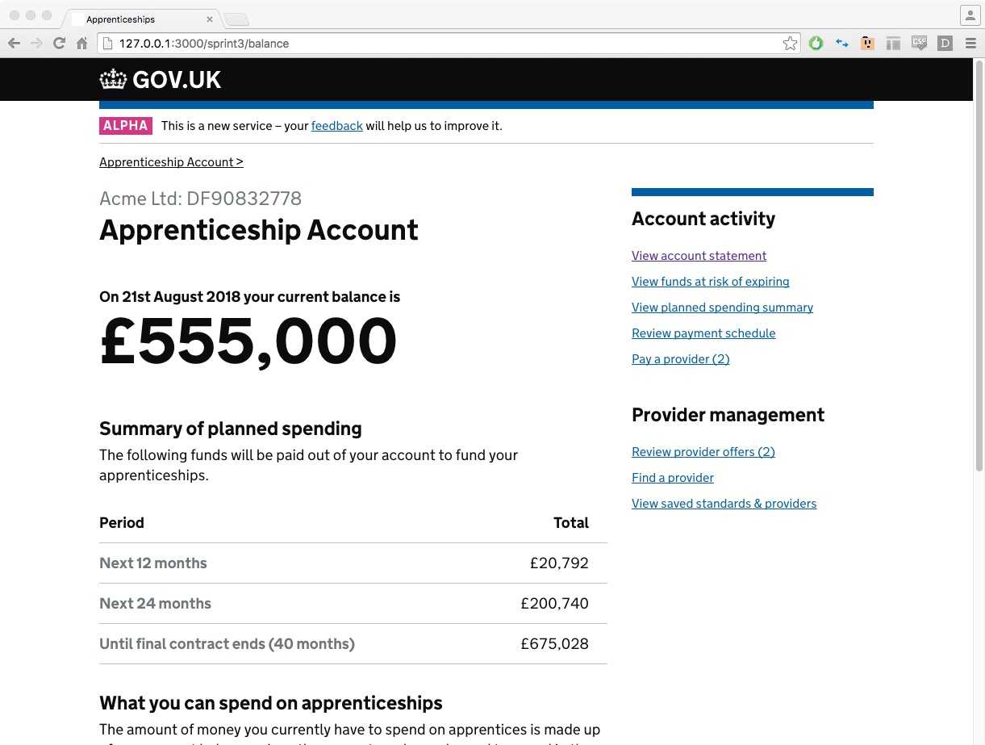
Notes:
SCREENGRAB – first level of work in alpha for levy account. Wireframe for testing. Walking users through then changing. THIS IS NOT THE FINAL PRODUCT – lots of work still to do with users.
Reference – secure identity check linked to HMRC/PAYE (offline)

Slide 15
Apprenticeship Standards

Slide 16
Apprenticeship standards overview
Giving employers the opportunity to set the skills, knowledge and behaviours you need
Employer-led Trailblazers designing apprenticeship standards
Short, concise standards replace long, complex frameworks
Providing a clear and attractive ‘shop window’ for parents, apprentices and businesses
All apprenticeship standards have an end point assessment
Ensuring that apprentices are signed off as fully competent at the end of their apprenticeship
All apprenticeships must last at least 12 months
Continuing to drive up the quality of apprenticeships
Occupation, (entry requirements), knowledge, skills, experience, duration, level
Notes:
A quick reminder of the main reasons and purpose of the reforms.
The standards are designed and developed by employers, and initially they are developing a short two page document, which act as a shop front for their new apprenticeship – so the audience for that document is broad – employers, parents, prospective apprentices and providers.
The document is the apprenticeship standard for that occupation, so widespread backing of from both large and small employers and relevant professional bodies is essential.
In its most basic form describes the role/occupation and the skills knowledge and behaviours an individual will have when they are fully competent in that role (i.e. at the end of the apprenticeship).
Its that 2 page document that we are going to focus on in this session.
Worth noting upfront that we should be referring to the new apprenticeships as either ‘apprenticeships’ or apprenticeship standards’ – not trailblazers or trailblazer apprenticeships. We do still use the term trailblazers, but only to refer to eth groups of employers that develop the apprenticeship standards. We need to esnure we are mainstreaming the standards – not seen as a tria.

Slide 17
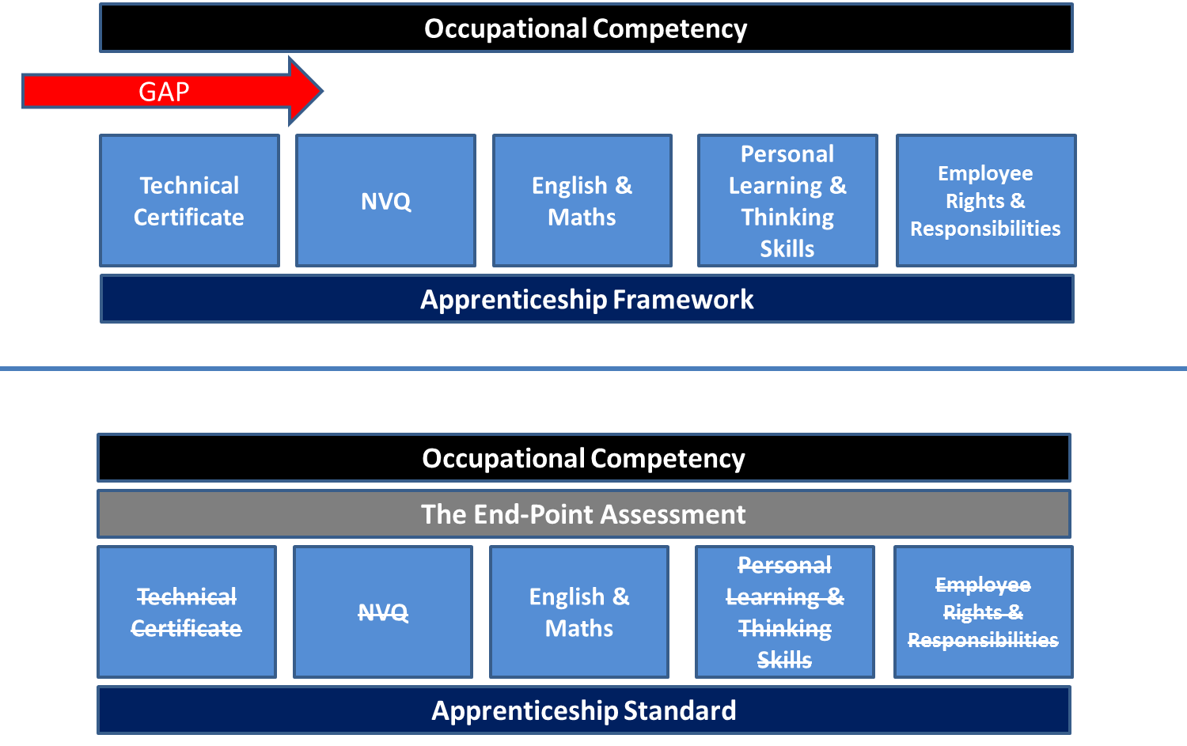
Standards vs Frameworks
Notes:
This slide summarises the key differences between frameworks and standards. With frameworks you have a series of qualifications that once successfully completed means the apprentice has completed their apprenticeship.
Employers were saying that this approach didn’t always lead to a competent person who could really do the job. So the focus for the standards is not about what is delivered ‘on-programme’ or a series of qualifications, but about setting out clearly what competence should look like for that occupation (in the two page standard) and utilising an end point assessment which ensures the apprentice can really demonstrate that they are competent and can do the job.

Slide 18
Developing Apprenticeship Standards – the process
Employer group bid to become a Trailblazer/develop a new Standard
Gateway 1: Greenlight to develop the Standard
Gateway 2: Approval of the Standard
Trailblazer develops Standard
Trailblazer develops Assessment Plan
Gateway 3: Approval of the Assessment Plan and assignment of final funding cap
Delivery can begin!
At each gateway there is an online consultation run by BIS to get wider input and views which are fed back to the trailblazer
Notes:
Again this is just a reminder of the process the trailblazer groups are going through.
When they come to start writing their 2 page standards they have already been though one approvals process known as ‘gateway one’ where their initial expression of interest’ to develop particular standard or standards has been approved for development by BIS and the minister. At this point the standard is listed as ‘in development’ on GOV.UK, but this gives no guarantees that the final standard will be approved and published.
Online consultation available to all to comment at each submission/gateway

Slide 19
Apprenticeships: standards and frameworks
Standards
> 380 standards published (222) and in development
> 60 are higher and degree apprenticeships
Levels 3 – 6 (degree)
Broad sector range: digital industries, energy and utilities, healthcare, hospitality
https://www.gov.uk/government/collections/apprenticeship-standards
Frameworks
215 “live” frameworks
Levels 2 – 5
https://www.gov.uk/government/publications/apprenticeship-frameworks-live-list

Slide 20
Get in touch
Employer helpline: nationalhelpdesk@apprenticeships.gov.uk
Phone: 08000 150 600
Levy items/aspects: apprenticeships.levy@bis.gsi.gov.uk
Digital Apprenticeship Service
DASenquiries@sfa.bis.gov.uk

