Slide 1

The Apprenticeship Levy

Slide 2


The Levy is part of a broader programme of reforms
The government is committed to significantly increase the quantity and quality of apprenticeships in England to reach 3 million starts in 2020:
New Institute for Apprenticeships led by employers to support quality apprenticeships
Employers at the heart of designing new Apprenticeships Standards through the Trailblazer programme
Apprenticeships will be given equal legal protection to degrees
Abolishing employer NICs for apprentices under the age of 25 from April 2016
Apprenticeship targets for public sector bodies – consulting on new duty on public sector to have 2.3% of its workforce comprised of apprenticeships
But a step change in the scale and quality of the apprenticeship programme also requires a step change in funding.

Slide 3
Action is needed to address current trends
UK productivity lags behind other developed economies…
Number of employees who worked fewer hours than usual because they attended a training course away from their workplace
… and employers are investing less in training
…and employers are investing less in training

Slide 4
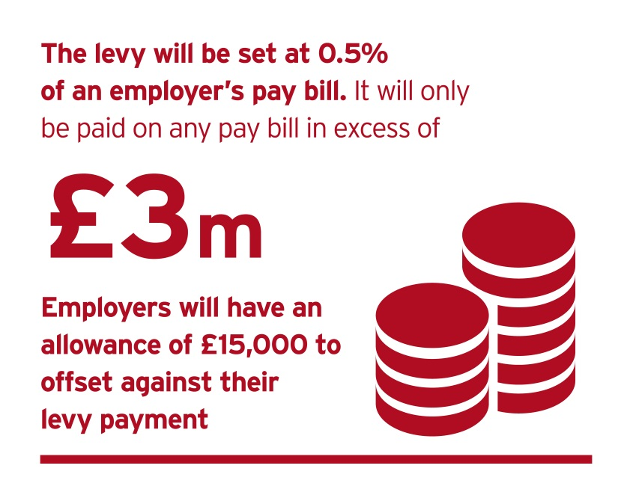
The Spending Review set the rate and scope of the levy
The levy will be 0.5% of paybill, paid through PAYE
An allowance of £15,000
Levy paid on paybill in excess of £3m (2% of UK employers)
Employers in England who pay the levy and are committed to apprenticeship training will be able to get out more than they pay into the levy, through a top-up to their digital accounts

Slide 5
Two worked examples:
Employer of 250 employees, each with a gross salary of £20,000.
Pay bill: 250 x £20,000 = £5,000,000
Levy sum: 0.5% x £5,000,000 = £25,000
Allowance: £25,000 - £15,000 = £10,000 annual levy payment
Employer of 100 employees, each with a gross salary of £20,000.
Pay bill: 100 x £20,000 = £2,000,000
Levy sum: 0.5% x £2,000,000 = £10,000
Allowance: £10,000 - £15,000 = £0 annual levy payment

Slide 6
Getting out more than you put in
Employers who pay the levy and are committed to apprenticeships training will be able to get out more than they pay in to the levy.
The government will apply a 10% top-up to monthly funds entering levy paying employers digital accounts, for apprenticeship training in England, from April 2017.
Employer has £12,000 annually entering their levy account
Monthly account funding = £1,000
Top up: 10% x £1,000 = £100
Levy monthly account increase: £1,000 + £100 = £1,100
£13,200 annually to spend on Apprenticeships
Worked example

Slide 7
How the Levy will work
Top up
HMRC collect levy (PAYE)
Employer has online
account
Employ Apprentice
Pay for training with “vouchers”
Receive training for apprentice
Unused vouchers expire
Employer
Our objectives: Employer control and simplicity
Training
Provider
Register with SFA
(Ofsted)
Offer apprenticeship training
Receive vouchers (Digital Service)
Provide training to apprentice
Redeem “vouchers”
Pass data on levy payments from HMRC to BIS
Timely data on training
Check training is complete
If funding unlocked: Pay provider
Government
Employer and Provider Identity Assurance
Our objectives: Get the machinery right to provide a quality service while protecting public purse

Slide 8
Next Steps
SPRING 2016
AUTUMN 2016
BY END 2016
APRIL 2017
High Level Scope
February 16 - HMRC published draft clauses for levy legislation on collection of the levy
Operating Detail
BIS/DfE publish
final funding rates
Transition
SFA publish draft
funding rules
SFA publish final funding rules
DAS registration opens
BIS/DfE publish draft funding rates
April 16 –
BIS/DfE publish Employer Guide (broad operating model for the levy)
Enterprise Bill and Finance Bill Royal assent.
ITB consensus consultation launched.
Full set of final funding guidelines published
Operation
  DAS operational
  New funding model live
  IfA in place
  New ITB levy orders in effect

Slide 9
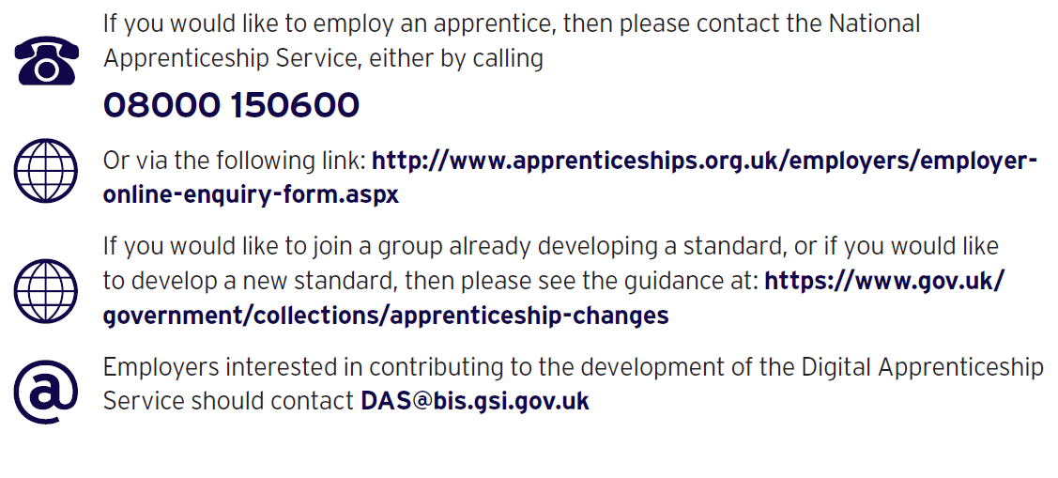


How to Get Involved
If you want to advertise an apprenticeship or find out about apprenticeships in your area you can visit https://www.gov.uk/apply-apprenticeship
If you want to provide any feedback on the apprenticeship levy, you can email apprenticeshipslevyconsultation@bis.gsi.gov.uk

