Slide 1

EHOD Skills Plan – Evidence Base
Ben Neild

Slide 2

Content
• Look at how the EHOD Economy has been changing (Demand)
• Review educational attainment (Supply of skills)
• Consider mismatches
• Suggest some possible priorities
Notes:
Don’t have a mandate… isn’t a skills plan, but could be a basis for one….

Slide 3

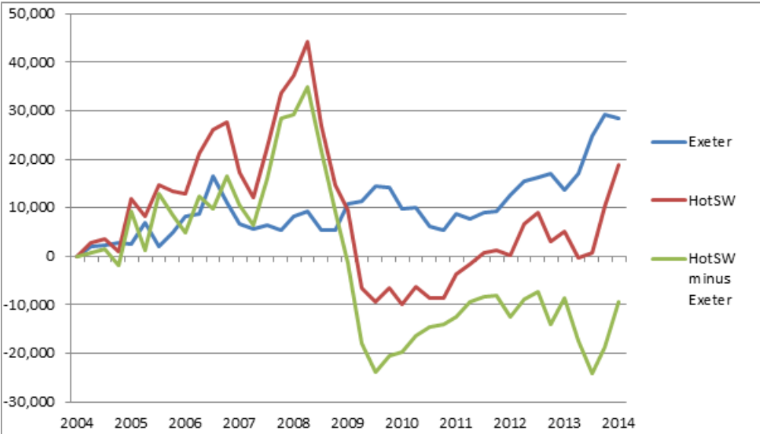
Change in employment,16-64 year olds, workplace
Notes:
In 2014, 218,000 people employed in EHOD - 11% more than a decade earlier.
Nationally employment grew by 6%
HotSW it grew by just 3%.
Huge issue about Economic Development…. Surging or lagging areas????

Slide 4
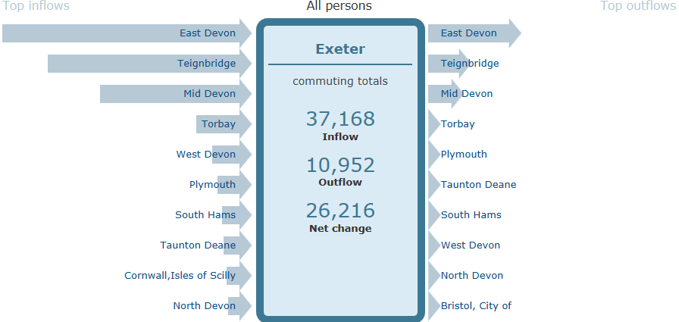
Within EHOD, employment grew by 28,000 in Exeter and fell by 8,000 across the 3 other district authority areas.
However, EHOD is a relatively coherent labour market
Notes:
Within EHOD, driven by Exeter
Employment in the three EHOD districts around Exeter declined by -7,000 in last decade
But, this is massively outweighed by employment growth within Exeter (+28,000)

Slide 5

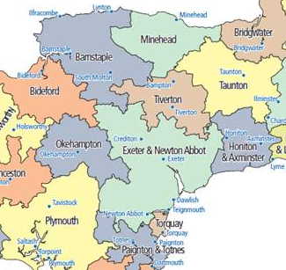
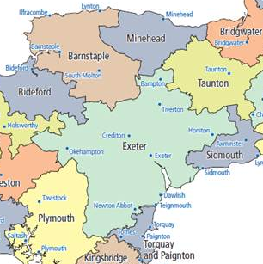
2001
2011
Travel to work areas

Slide 6

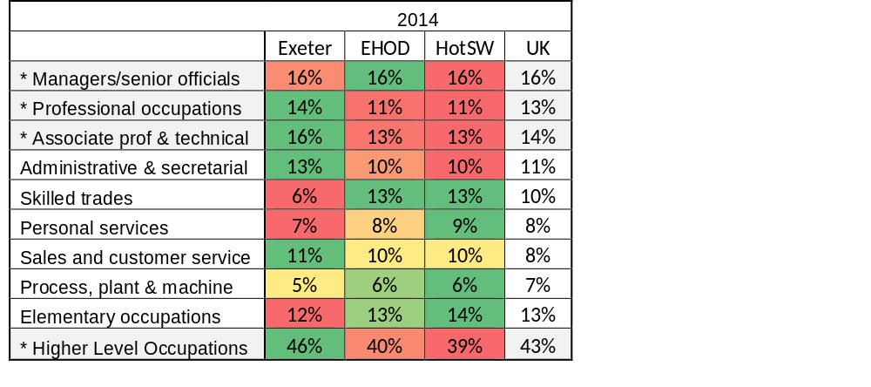
Employment by occupation
Exeter has a concentration of employment in the higher level occupations.
Employment in these occupations (46%) rose by 5 percentage points from 2004 – 2014, compared to 4 in HotSW and 3 across UK.
Notes:
So, not only more jobs, but more of the right kind of jobs.

Slide 7

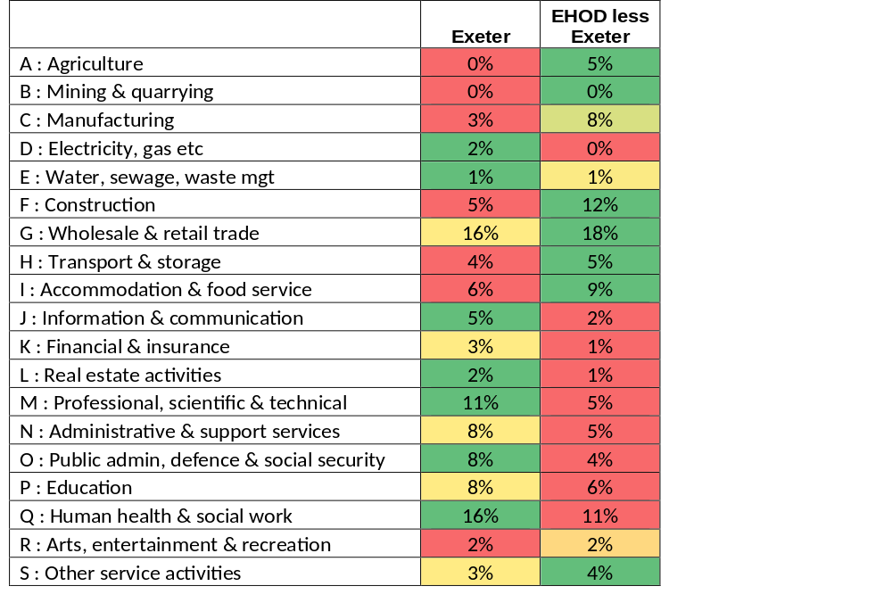
Employment by industry
Exeter’s industrial strengths differ to those of the surrounding area. The two are complementary elements of the a unified labour market.

Slide 8
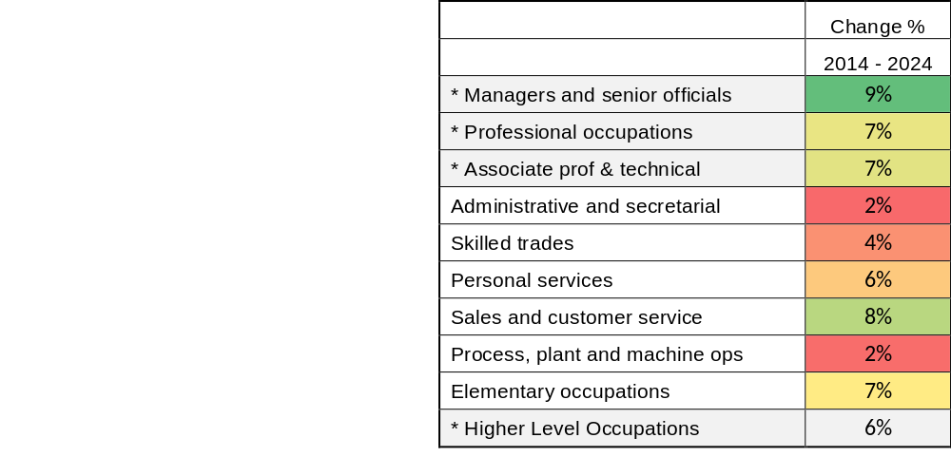
Employment Projections
Employment is projected to continue to become increasingly knowledge intensive, though there is some debate about this.

Slide 9

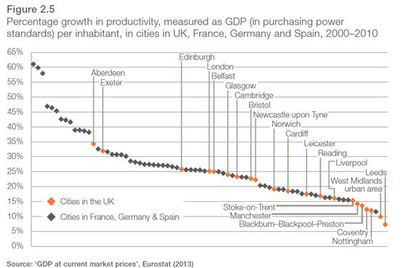
Productivity
Notes:
Surging GVA

Slide 10
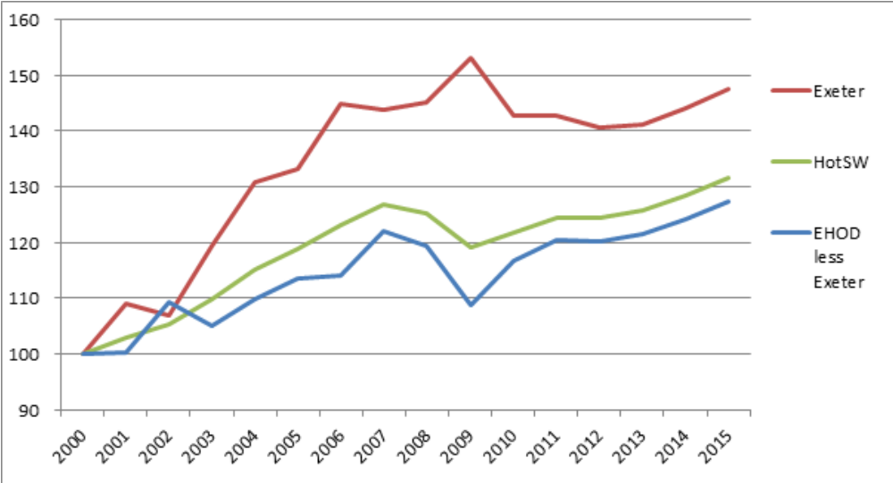
GVA (£m, 2009 prices), indexed, 2000 = 100
Notes:
Surging GVA

Slide 11
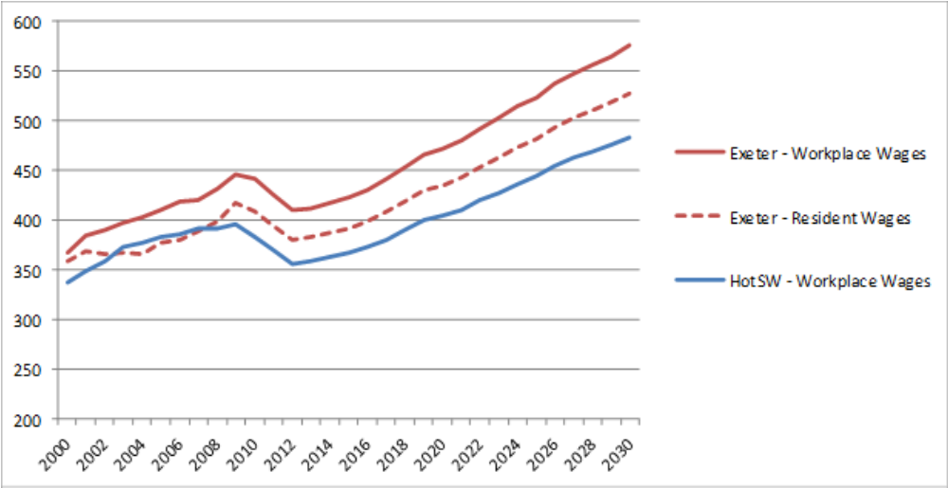
Workplace wages (£ per week, 2009 prices)
Notes:
Resulting in increase in wages (not inflation adjusted). Important thing is that Workplace wages faster than resident wages… benefit felt by those commuting into to relatively well paid employment in Exeter.

Slide 12

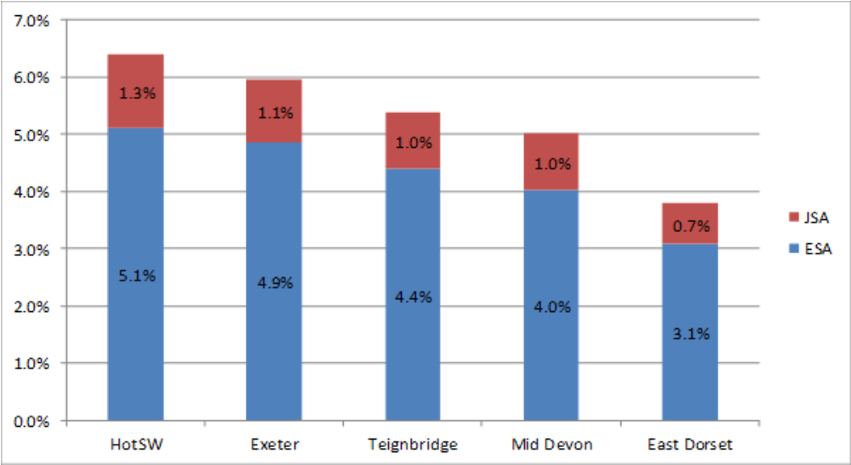
% working age population claiming JSA or ESA
Notes:
Benefits not universally shared…
Not all Rosy
Like London or anywhere else, are pockets of deprivation.

Slide 13
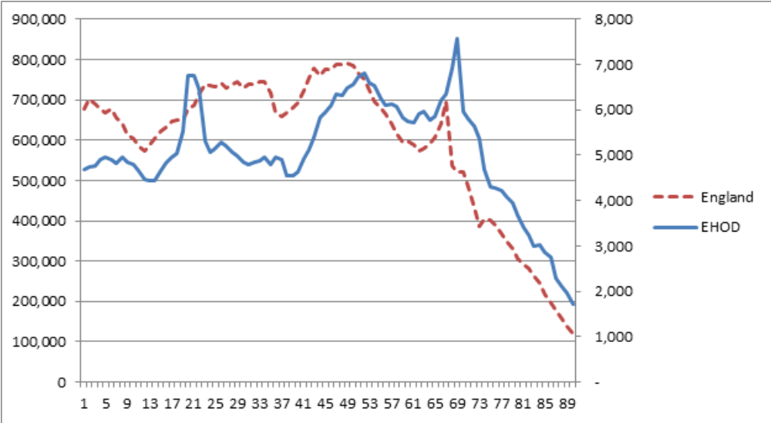
Population Profile
Notes:
Increase in the number of v. young people not as marked as it is nationally.
Huge spike of 18 to 20 year olds, due the influx of students
Dramatic fall in 20 and 24 yr olds as students leave.
Stable but small cohort of adults in early to mid-careers;
Many 40 to 50 year olds relocating / bringing skills to EHOD in late-careers (there are one third more fifty year olds than forty year olds.)
Huge ‘spike’ of baby-boomers, aged 65 to 68, leaving the labour market.

Slide 14
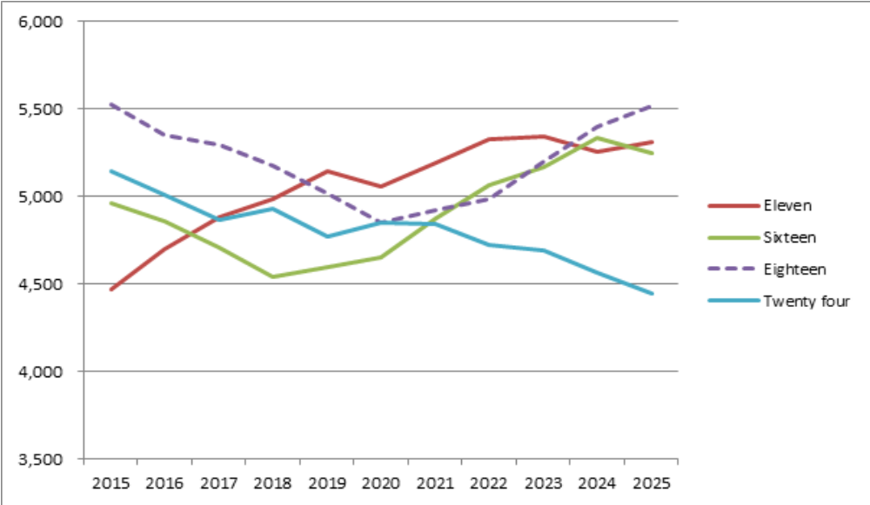
Young people entering / leaving education,
training & the labour market, HotSW
Notes:
Number of 11 year olds is projected to rise, and rise significantly… primary school expansion..
Flows through to sixteen year olds from 2018. Falls for next couple of years, dramatically
University entrance at eighteen… purple dotted… will be struggling to maintain numbers to 2020.
And 24 years… goes on falling over the entire period. In 2025 will be fifteen percent fewer. Won’t be a bad time to be leaving university!

Slide 15
Educational Attainment

Slide 16

Key Stage 2 and 3
Key Stage 2
A higher proportion of pupils in Devon (81%) attain the expected standard in reading, writing and mathematics tests (taken aged 11) than in other parts of the LEP area or England as a whole.
Attainment in mid Devon is lower than in the other EHOD districts.
Key Stage 3 – No longer collected but in 2013, attainment in Devon was above average.

Slide 17
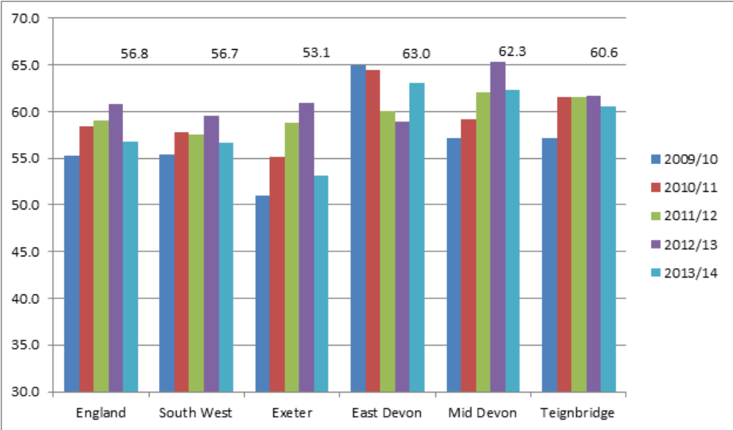
Key Stage 4 / GCSE
% of pupils attaining 5+ GCSEs at A* to C, including English & Maths
Notes:
Michael Gove’s reforms
Excludes non academic qualifications
Include only first attempt
No qualification more than one GCSE
Exeter, having previously been ahead of England & SW lags at Key Stage 4
Performance varies significantly from school to school
St James, 46% in 2011 and 64% in 2014
West Exe, 51% in 2011 and 44% in 2014
Be careful… depends on exam policies and how have been affected, but St James, special measures 11 years ago, does show performance can improve & improve dramatically.

Slide 18
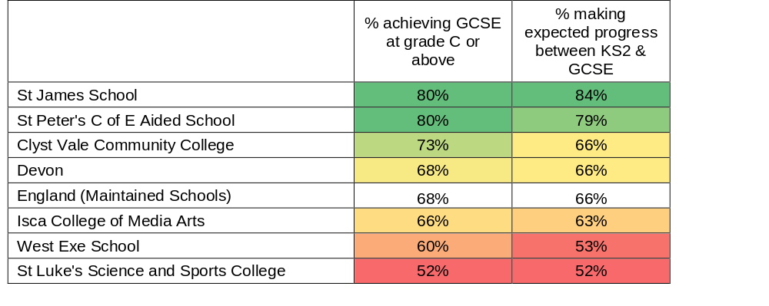
Attainment in mathematics
Has particular relevance to the Innovation Exeter focus on data analytics.

Slide 19
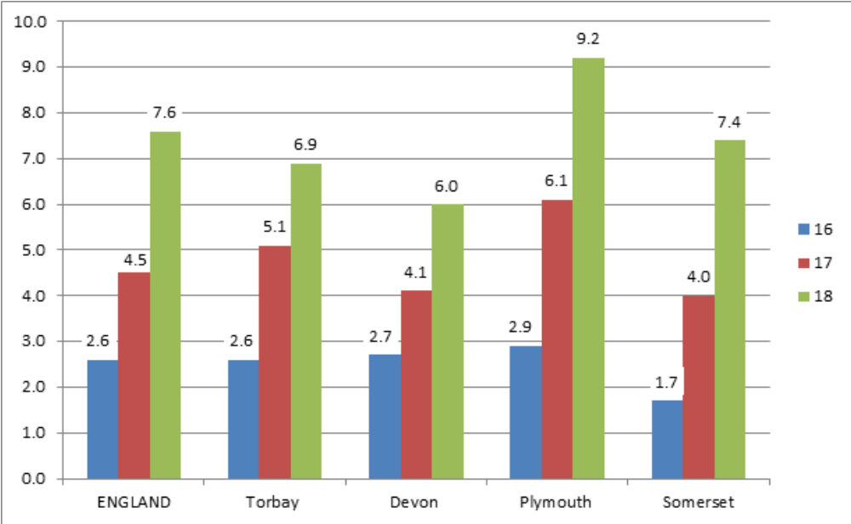
Not in Education Employment or Training
Notes:
Brief word about this.
Not substantially worse than other areas.. Bit better
Not undifferentiated mass… 18 year olds
But not good at this transition.
Youth Unemployment much higher than adult unemployment in UK. Not true in Germany, Austria where dual system etc. Is important and a national issue. Can’t be complacent.

Slide 20
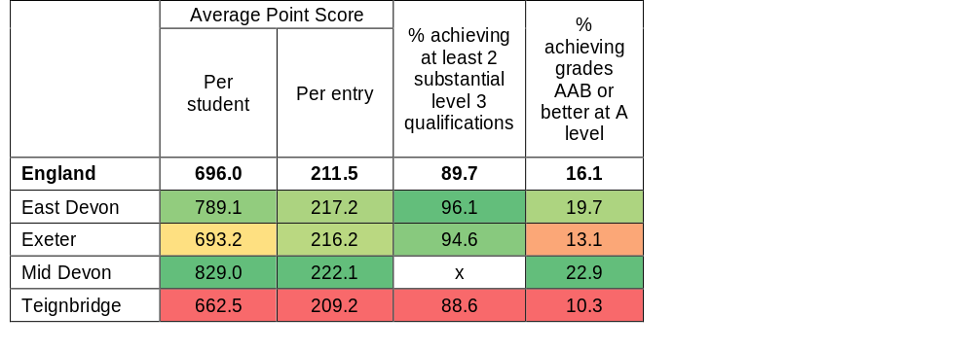
A Level / Level 3 Results, 2013/14
Notes:
Do pretty well in all areas, apart from Teignbridge, which is affected by things like presence of Torbay Grammars. Need to be careful.
East & Mid Devon do very well.
If take Exeter, which was lagging at KS 4/GCSE, a higher than average proportion gain at least 2 substantial Level 3 quals. Points per entry are above national average and points per student, petty much in line with average.

Slide 21
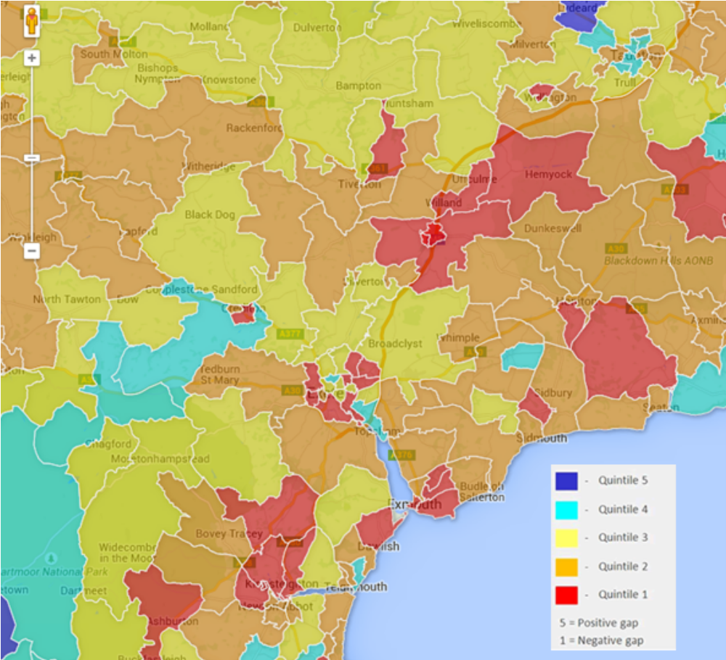
HE Participation
Relative to expectations based on educational attainment, progression rates to higher education are low.
Notes:
Whole of the SW is pretty orange and red… widening participation / raising aspirations is an issue.

Slide 22
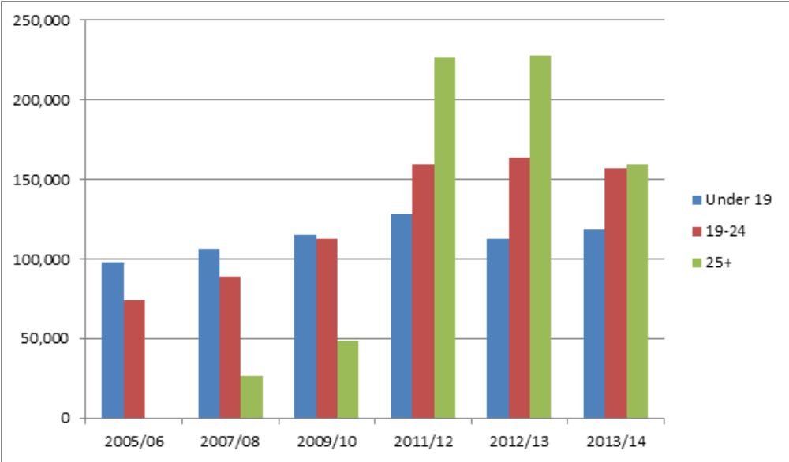
Apprenticeships
Notes:
Don’t want to say too much.
Apprenticeships can be great. Highest financial returns to any qualificaiton. Policy is chaotic. 9 types of apprenticeships. Been periodically undermined by chasing volumes… can see what happened in 2011/12.
Alison Wolf’s piece that led to Employer Apprenticeship Levy recommended abandoning targets / volumes, focusing only on employer ownership.
But George Osborne read it after he’d written the manifesto and before the spring budget. Have two policies… growing numbers and ownership/levy.
Reflects where we are in economic cycle…. Are they about high skills, progression productivity… of a method of getting young people off the unemployment register during economic crisis.
Can be great… or can be pretty poor and way of employing young people on the cheap. The latter is not worth focusing on. Focus on high value, high quality apprenticeships. Focus on productivity gain, skills shortages, progression routes for individuals. Lots can and should do, but targeted approach.

Slide 23

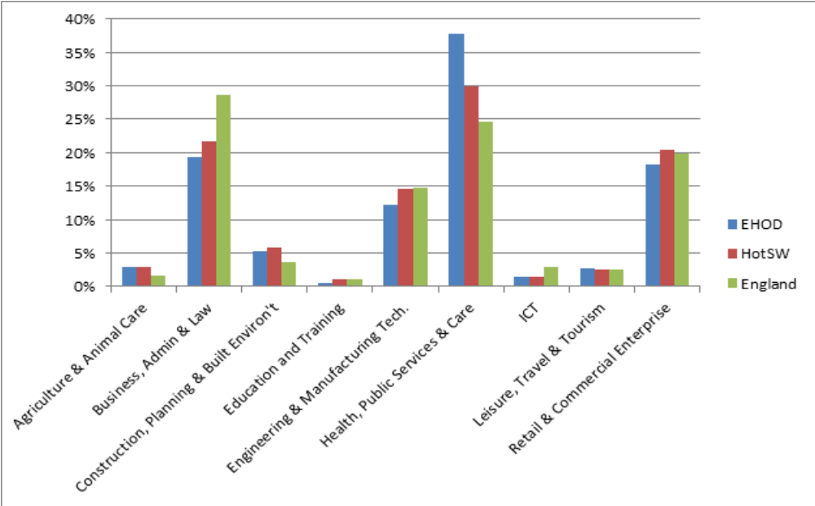
Apprenticeships by industrial sector
Notes:
In EHOD four ‘sector subjects’ accounted for 87% of Apprenticeship starts in 2013/14
About half of all apprenticeship growth between 2005/06 and 2013/14 was due to growth in Health, public services and care.
Growth in Construction and Engineering & Manufacturing technologies has been minimal.

Slide 24

Apprenticeships
Not all apprenticeships are of equal value. There is a strong case for focusing on those that:
Support the transition of young people into the labour
Support the acquisition of skills to Level 3 and above;
Support economic growth in important industrial sectors.

Slide 25
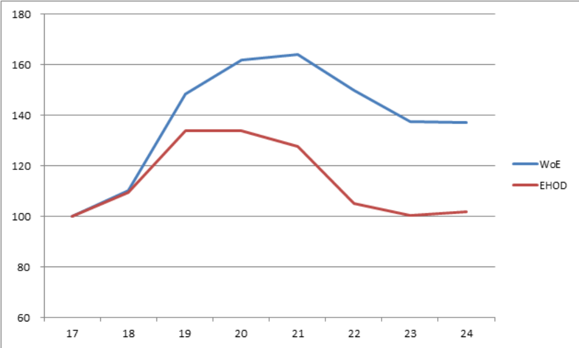
Making the most of graduate skills
Demographic profile, 17 to 24 year olds indexed (17 = 100), EHOD & WoE

Slide 26
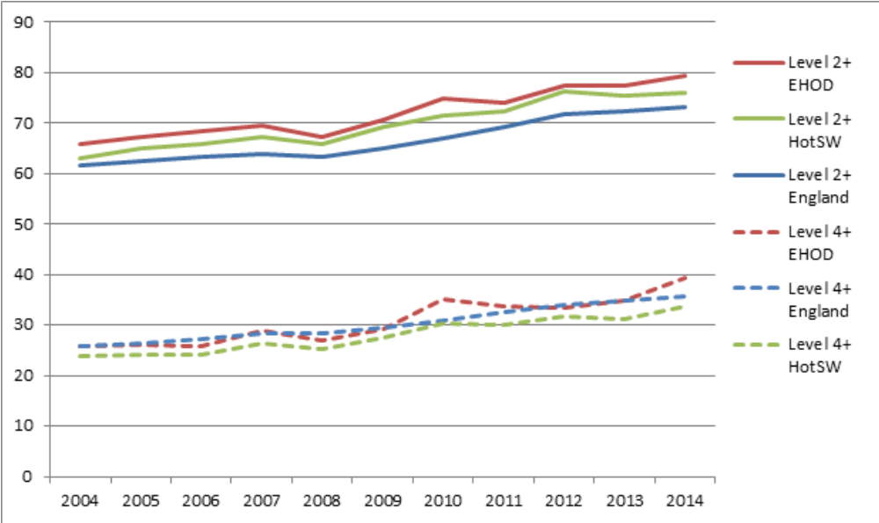
Adult Skills
Percent with qualifications at Level 4+ and Level 2+

Slide 27
Skills Gaps and shortages
 | 16 year olds |  | 17 - 18 year olds |  | HE Graduates
 | England | Devon | England | Devon | England | Devon
Very well / well prepared for work | 59% | 68% | 66% | 73% | 83% | 86%
Poorly / very poorly prepared for work | 36% | 28% | 29% | 24% | 13% | 11%
However, the labour market is tightening.
In 2011, 16% of vacancies remained unfilled because employers couldn’t find applicants with the required skills.
In 2013, this figure had increased to 22%.

Slide 28

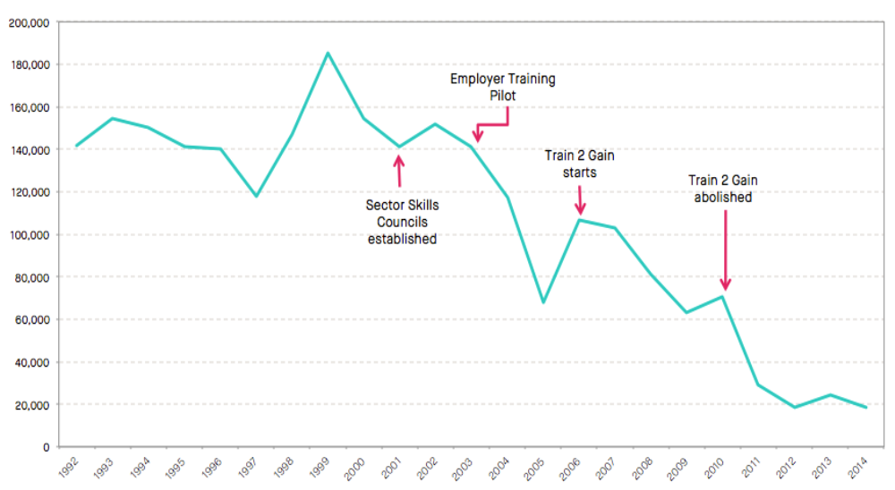
Time off to train
% of employees working fewer hours because of training

Slide 29

Potential Priorities
• Improving Information Advice and Guidance
• Linking local people to local job creation
• Growing the number of quality apprenticeships
• Addressing low levels of progression into Higher Education
Graduate Retention / making use of the available skills
Addressing technical / Higher level skills gaps,
especially in strategic sectors
Notes:
Pursuit of all of these to create a ‘pathway’ in key sectors / opportunities

Slide 30
Data Analytics
Improve the teaching of mathematics in schools and colleges
Provide more and better IAG re careers in data analytics
Embed data analysis in other subjects
Support the development of extra-curricular data activities
Develop an apprenticeship pathway in Data Analytics
Boost the employability /retention of graduates w/ data analytics
Raise business awareness of the value of data
CPD data professionals

Slide 31
Thank You
Contact us: Ben Neild
b.neild@exeter.ac.uk
01392 264823

